Slide 1


MESSAGE FRAMING OF
FACEBOOK POSTS:
An Analysis of Non Governmental Organizations (NGOS)
Özge Özgen
Banu Atrek
Sumeyra Duman Kurt
Canan Madran
2nd International Biannual Social Business@Anadolu Conference
Social Business: Business As If People Mattered
12.6.2015 - Eskişehir

Slide 2
Structure
Introduction
  Social Networking Sites, NGOs and Message Framing
Research Objectives
  analyzing the Facebook posts of the NGOs and exploring their message framing determinants
  identifying whether responses (like, share, comment) differ according to the types of framing determinants
Message Framing Literature
Methodology
Findings
Conclusion

Slide 3
Message Framing Determinants in
Social Marketing
Framing
  way of selecting some aspects of perceived reality and
  making them more noticeable, meaningful, or memorable to the audience in a communicating text (Entman, 1993)
Primary framing determinants in social marketing within a holistic model
  “content, time horizon, focus, direction, and tonality” (Helmig & Thaler, 2010)

Slide 4
Message Content
informational/promotional/community building messages,
messages focusing on prevention/detection behavior,
qualitative/quantitative messages, single/multiple message(s), and
messages with unknown/known facts
(e.g., Guidry, Waters & Saxton, 2014; Helmig & Thaler, 2010; Lovejoy & Saxton, 2012)
Informational
marketing messages
public education messages
Promotional
call-to-action messages
events and promotion messages
Community Building
fundraising messages

Slide 5
Message Focus
egoistic(self-oriented)/alturistic(other-oriented)/biospheric(other oriented) messages and
testimonial dimension which consists of celebrity, expert, volunteer testimonials
(Helmig & Thaler, 2010; Reinard, 1998 as cited in Stewart, 2014; Schultz & Zelezny, 2003)
Egoistic
self-oriented goals such as health, quality of life, prosperity, convenience
Altrustic
concentrate on other people such as children, family, community, humanity
biospheric messages give attention to the well-being of living things such as plants, animals, trees
Biospheric

Slide 6
Message Direction and Tonality
Direction
  Positive or negative and gain or loss framed messages
  (Kahneman & Tversky, 1979, 1982; Tversky & Kahneman, 1981)
Tonality
  Emotional or rational gain/loss
  Brennan & Binney, 2010 Helmig & Thaler, 2010; Laverie & McDonald, 2007

Slide 7
Research Questions
RQ₁₋₅: What are the (1)message content, (2)time horizon, (3)message focus, (4)message direction and (5)message tonality of Facebook posts of Turkish NGOs?
RQ₆: How does the use of message framing determinants on Facebook with respect to (a) message content, (b) time horizon, (c) message focus, (d) message direction (e) message tonality differ between the Turkish NGOs and Greenpeace International?
RQ₇: Which types of message framing determinants elicit more Facebook responses with respect to (a)like, (b)comment, and (c)share?

Slide 8
Methodology (1)
Exploratory study and content analysis
The list of all NGOs that operate in Turkey
  56 foundations were categorized under 5 groups:
  health, culture and education, environment, society and profession.
      Foundations for professionals are disregarded from the analysis within the scope of this study.
One NGO which has the highest number of followers in Facebook was selected from each category
+++Greenpeace as one of the world’s most powerful NGOs

Slide 9
Methodology (2)
Between 01.10.2014 – 31.12.2014 (3 months period)
  the database contains → 152 posts
Message framing determinants of Helmig and Thaler (2010)
Using the refined coding protocol, two scholars coded all posts with 90% inter-coder agreement.

Slide 10






Reactions toward the Social Media Posts of Selected NGOs
Category of NGOs
Health
Environment
Education
Society
Culture
NGOs
Number of Posts
26
26
30
14
16
40
Number of Likes
138,978
31,424
13,806
2,008
1,458
250,969
Number of Comments
1,099
213
79
17
17
15,656
Number of Shares
13,637
3,175
759
102
162
147,097

Slide 11
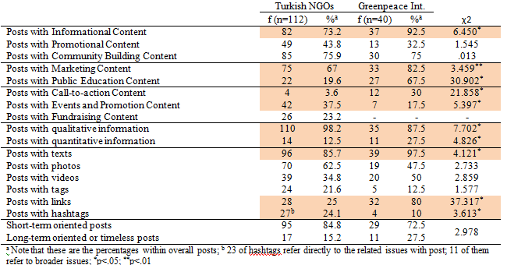
Message Content and Time Horizon of the Social Media Posts of Selected NGOs

Slide 12
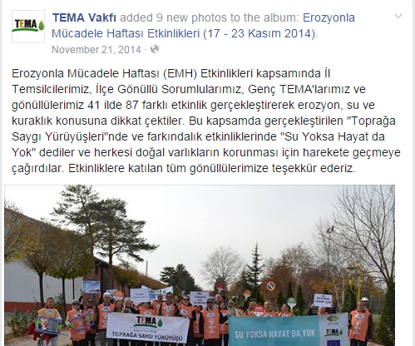
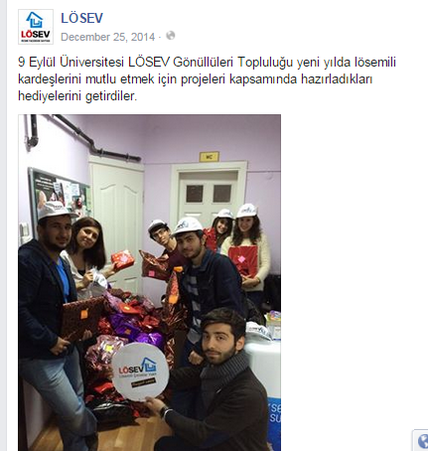
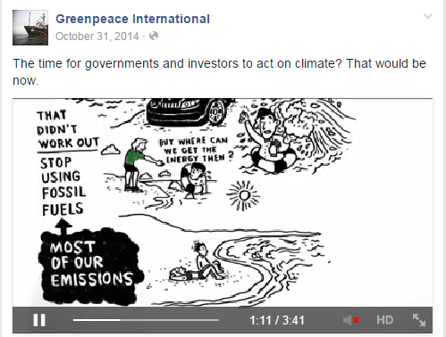

Slide 13
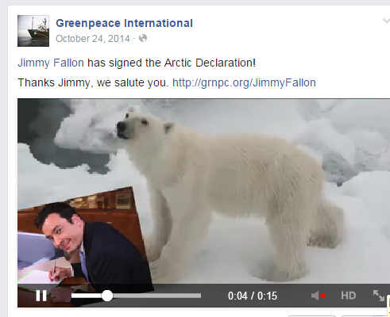
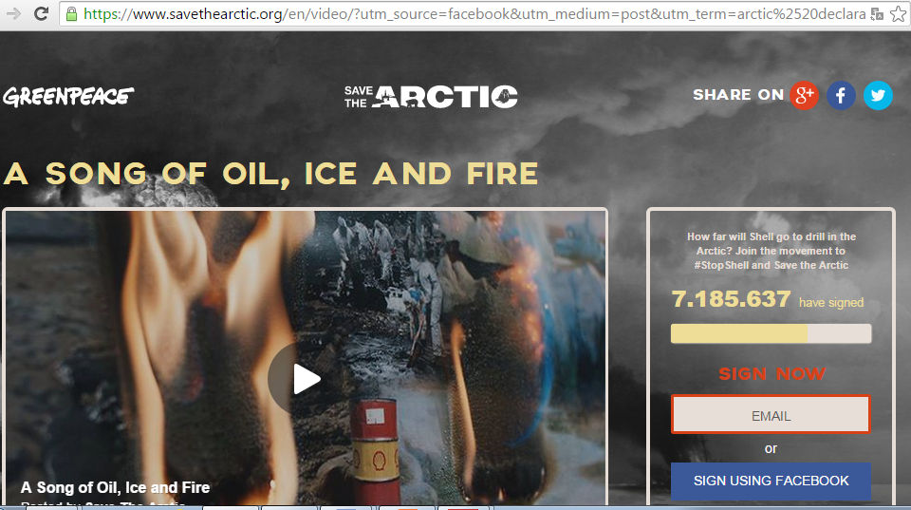

Slide 14
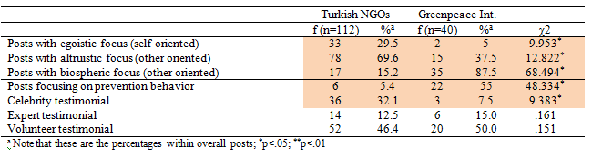
Message Focus of the Social Media Posts of Selected NGOs

Slide 15
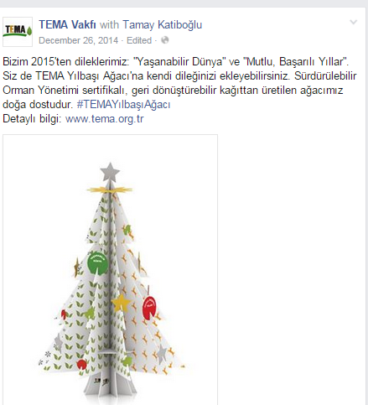
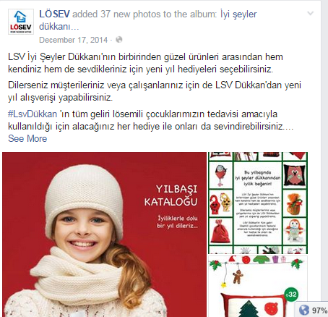

Slide 16
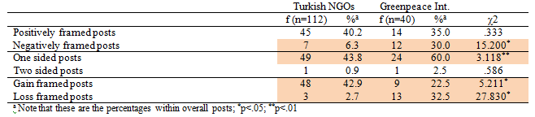
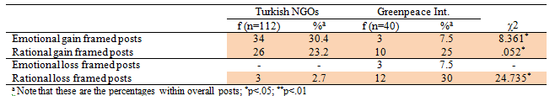
Message Direction of the Social Media Posts of Selected NGOs
Message Tonality of the Social Media Posts of Selected NGOs

Slide 17
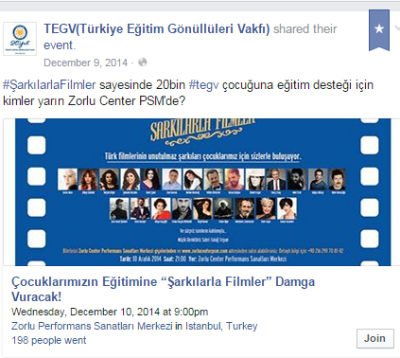
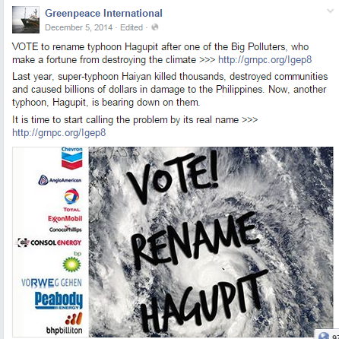
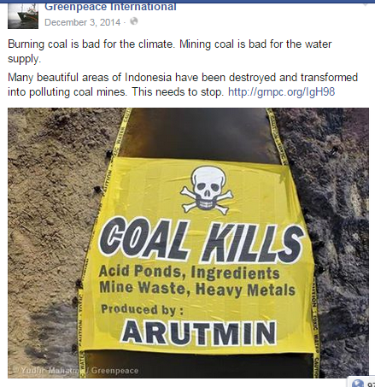

Slide 18
According to ANOVA Results for Turkish NGOs
Posts on special occasion days, “single” messages, having an “informational”, “community building” content, “altruistic” focus get more likes
It is also remarkable that volunteer testimonials trigger more response from the followers of these pages

Slide 19
Conclusion (1)
Usage of social media of NGOs → key to transform the society from “consumer to citizen“ (?)
Turkish NGOs
  do not facilitate Facebook effectively
  Facebook with a limited usage of public education and call to action content, less usage of rich media solutions, and prevention focus.
Greenpeace uses more negatively framed and loss framed messages while Turkish NGOs prefer positively framed and gain framed messages

Slide 20
Conclusion (2)
Facebook reactions are differing according to message framing determinants BUT!!!
the need to go beyond the aim of not only existing on Facebook but also facilitating the necessary usage of message framing and social media communication functions

Slide 21

CREATING
A CITIZEN
OR
A CONSUMER OF SOCIAL MEDIA WORLD
?

Slide 22
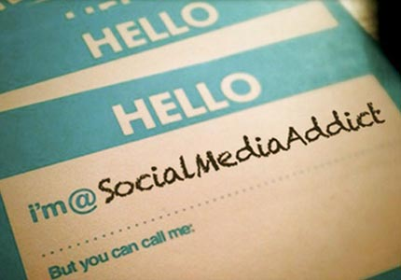
A CITIZEN

Slide 23
Thanks for listening, questions and contributions
Özge Özgen
Banu Atrek
Sumeyra Duman Kurt
Canan Madran
ozge.ozgen@deu.edu.tr
12.06.2015 -
MESSAGE FRAMING OF FACEBOOK POSTS: An Analysis of Non Governmental Organizations (NGOS)

