Slide 1
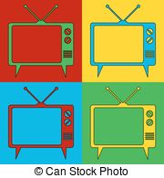
PUBLIC HEALTH AWARENESS ADVERTISING AND CONSUMER GUILT: A MODERATING ROLE OF CULTURE
Begüm Yetişer
PhD Candidate @ Department of Marketing, Ghent University
Begum.Yetiser@UGent.be

Slide 2
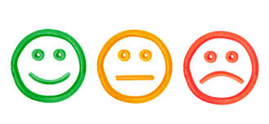
Emotions and Public Health Advertising
It’s Powerful!: Retracting emotional responses from consumers (Shimp & Stuart 2004; Berthon, Ewing, & Hah, 2005).
It’s Common!
It’s Subjective!: Subjective evaluation of the situation (Schmidt, Tinti, Levine, & Testa, 2010).
Notes:
Common: Mostly negative emotions are being used to fit the aim of the advertisement.
Subjective: The quality and the intensity of an emotion depend on an individual’s subjective evaluation of the situation in terms of a set of appraisal dimensions …

Slide 3
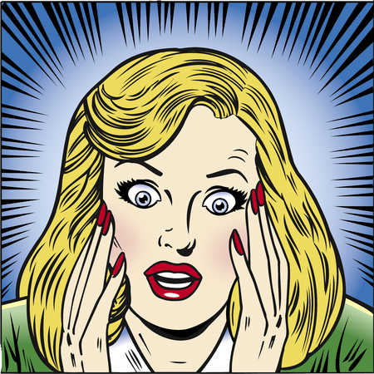
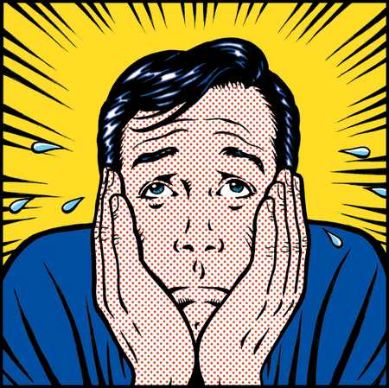
Fear, Guilt & Shame
FEAR: Anxious state that is caused by a negative consequence (Ghingold, 1981; Burnett & Lunsford, 1994).
GUILT: The act of violating one’s internal ethical standards (Ghingold, 1981).
SHAME: The motivation to escape from the situation as well as other individuals (Chun, Patrick & MacInnis, 2007).

Slide 4

Fear, Guilt & Shame
The intended emotions associated with the appeal have no guarantees over viewers’ felt emotions (Cotte, Coulter & Moore, 2005).

Slide 5
Fear, Guilt & Shame
Current Mood
Social Status
Educational Background
Fear
Guilt
Shame
Cultural Background

Slide 6
The Research
Emotions evoked by the advertisement
MATCH
The aim of the advertisement
Favorable comment on advertisement
Notes:
The Matching Hypothesis:
Fear, guilt and shame can be channeled through an individual’s mind-set to match the felt emotions aroused by the advertisement with the negative content.

Slide 7
The Research
Emotion Regulation
Cognitively regulating one’s emotions → better reaction towards an advertisement with negative emotional content (Ford & Mauss, 2013).
Reappraisal = savior
Indifference between cultures
Notes:
Discomfort may be felt more within interdependent cultures due to its tendency to put societ’s needs as priority.
Reappraising emotions does not differ across cultures.
So using fear, vs may be more insightful

Slide 8
The Research
Emotions → powerful
Discomfort felt → interdependent cultures
Society’s needs
Difference between cultures → variety → interdependent cultures may show more positive attitudes towards negative content than independent cultures

Slide 9
The Research Model
Culture
Negative Emotional Appeals
Fear
Guilt
Shame
Attitude Towards the Ad (AAD)

Slide 10
METHODOLOGY
713 respondents (29.1% women)
Qualtrics online platform
TR participants recruited randomly via social media.
US participants recruited via Crowdflower with 20 cents incentive.

Slide 11
METHODOLOGY
Independent Variable:
Felt Guilt, Shame and Fear (3-item, 7-point Likert Scale)
Dependent Variable:
Attitude Towards the Ad (3-item, 7-point Likert Scale)
Moderator:
Nation (0=Turkish, 1=US)

Slide 12
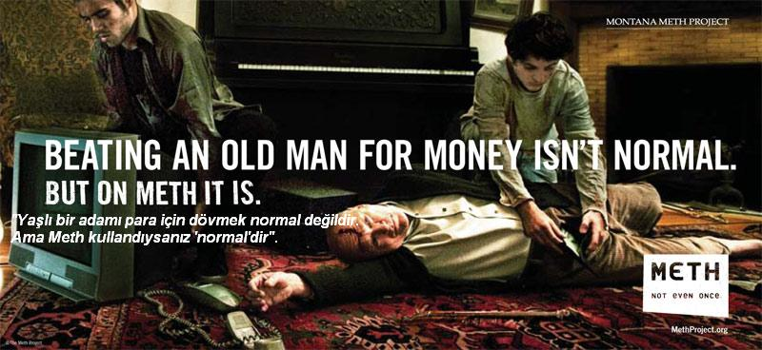
Public Health Advertisement

Slide 13
Results – Guilt Appeal
PROCESS (Model 1; Hayes, 2012)
Significant positive main effect of
Guilt (t=8.15; p<.001)
Nation (t= 5.26; p<.001)
Significant interaction effect (t=-4.93; p<.001)
Conditional positive effect for
Turkish (t=8.15; p<.001)
American respondents (t=1.34; p=0.18)
Notes:
Guilt: a high (vs. low) guilt appeal induces a more positive attitude for Turkish respondents whereas the same relation does not significantly different for American respondents.

Slide 14
Results – Fear Appeal
PROCESS (Model 1; Hayes, 2012)
Significant positive main effect of
Fear (t=7.64; p<0.01)
Nation (t=4.85; p<0.01)
Significant interaction effect (t=-4.82; p<0.01)
Conditional positive effect
Turkish (t=7.64; p<0.01)
American respondents (t=0.78; p=0.44)

Slide 15
Results – Shame Appeal
PROCESS (Model 1; Hayes, 2012)
Significant positive main effects for
Shame (t=8.55; p<0.01)
Nation (t=4.58; p<0.01)
Significant interaction effect
Conditional positive effect for
Turkish (t=8.55; p<0.01)
American respondents (t=1.42; p=0.15)

Slide 16
Discussion
?
Individualism X Collectivism: Cultural Discussion
Emotion Regulation Theory (John, Gross, 1998; 2003)
Transforming guilt, shame and fear into positive emotions → reappraisal
Different Interpretations:
Interdependent cultures: protecting loved ones
Independent cultures: protecting themselves

Slide 17
Thank You!

