Slide 1
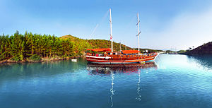
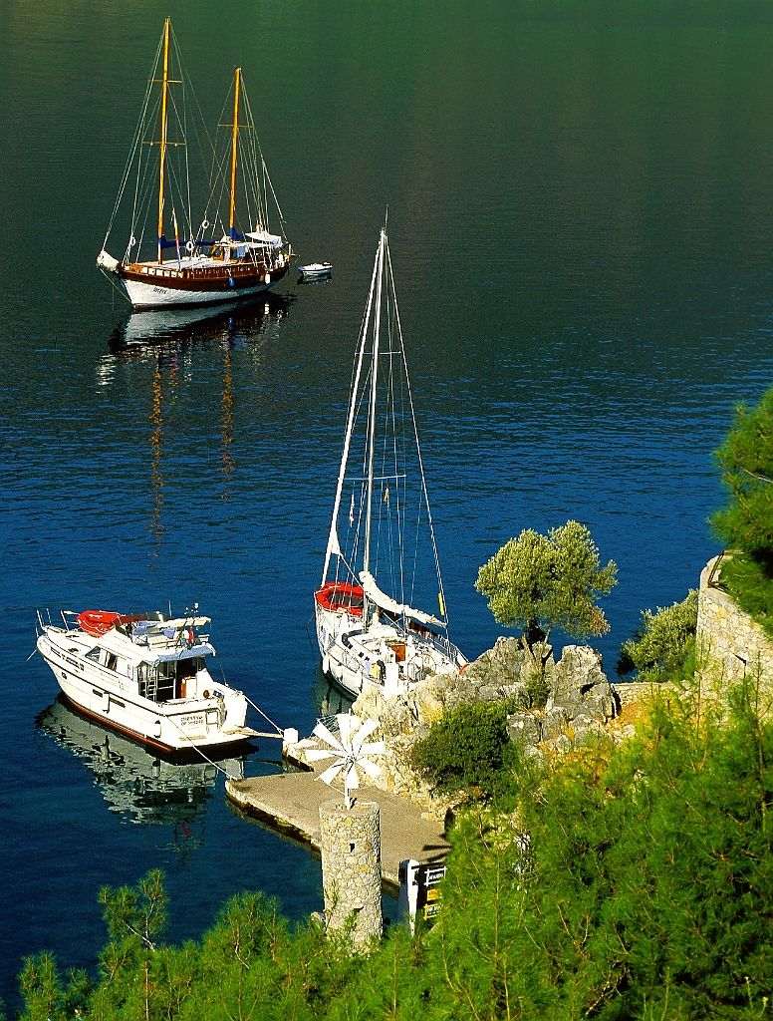
A Preliminary Study on the Motivation Factors for Blue Voyage Purchase Intention
Neslihan PAKER – Yaşar University
Serim PAKER- Dokuz Eylül University

Slide 2
AGENDA
Introduction and Aim of the Research
Literature Review on Blue Voyage, Hedonic Buying Motivations, Push Factors
Research Design and Methodology
Findings and Discussion
Limitations and Suggestions for Future Studies

Slide 3
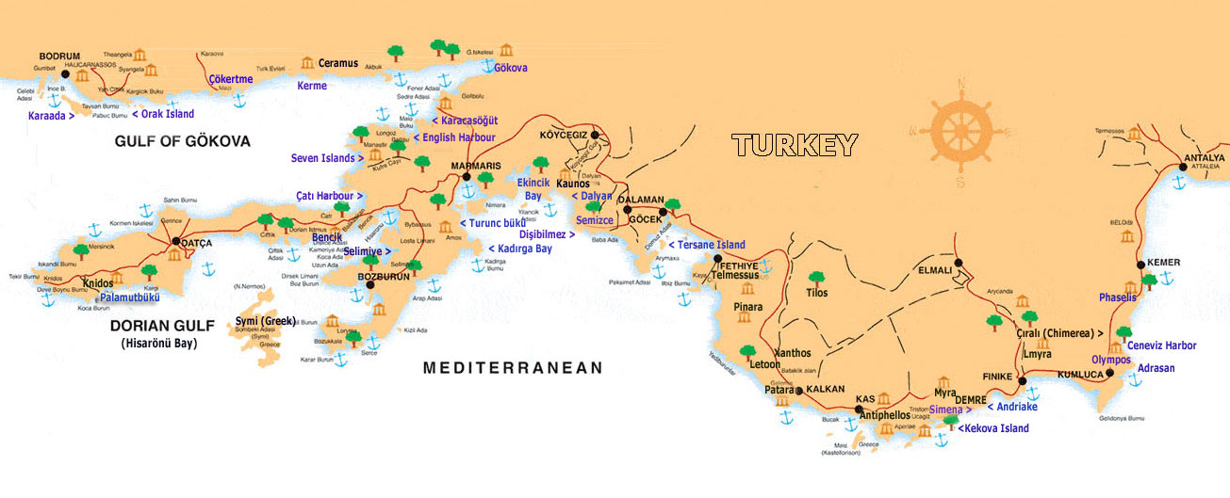
Introduction
Marine Tourism, Blue Voyage and Turkey
Importance of Blue Voyage for Turkey
Limited studies on Blue Voyage
2016 Tourism Emergency Plan
TCS has pioneered an executive committee
for marketing of Turkish Blue Voyage.

Slide 4
- Defining motivation factors for a blue voyage buying intention, making contribution to; - Marketing of blue voyage - Marine tourism literature
Aim of the Research

Slide 5
Literature Review

Slide 6
Blue Voyage:
Işık, Paker, and Şengönül, 2013:
Blue Voyage is simply a trip in a yacht on the sea
visits beautiful coves, bays
core aim is to discover nature, the voyagers himself/herself, and the other trip participants
İMEAK TCS, 2016
Blue Voyage has become popular with Cevat Şakir Kabaağaçlı, namely, The Fisherman of Halicarnassus in Turkey.
The Fisherman of Halicarnassus had made many blue voyages with his friends staying on board for long time periods taking only stopping for purchasing supplies.
He wrote many books on Aegean blue voyages, and blue voyage has affected his philosophy

Slide 7
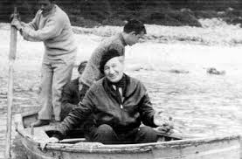

Slide 8
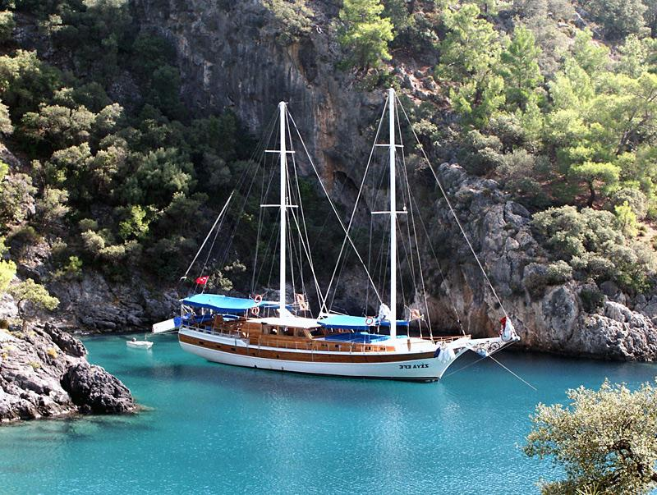
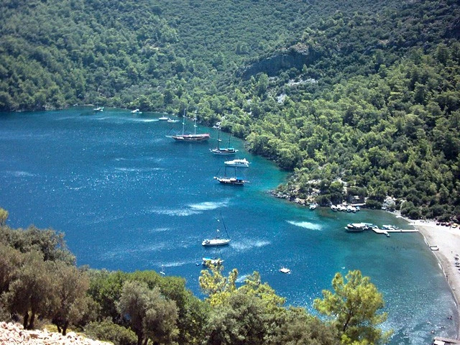
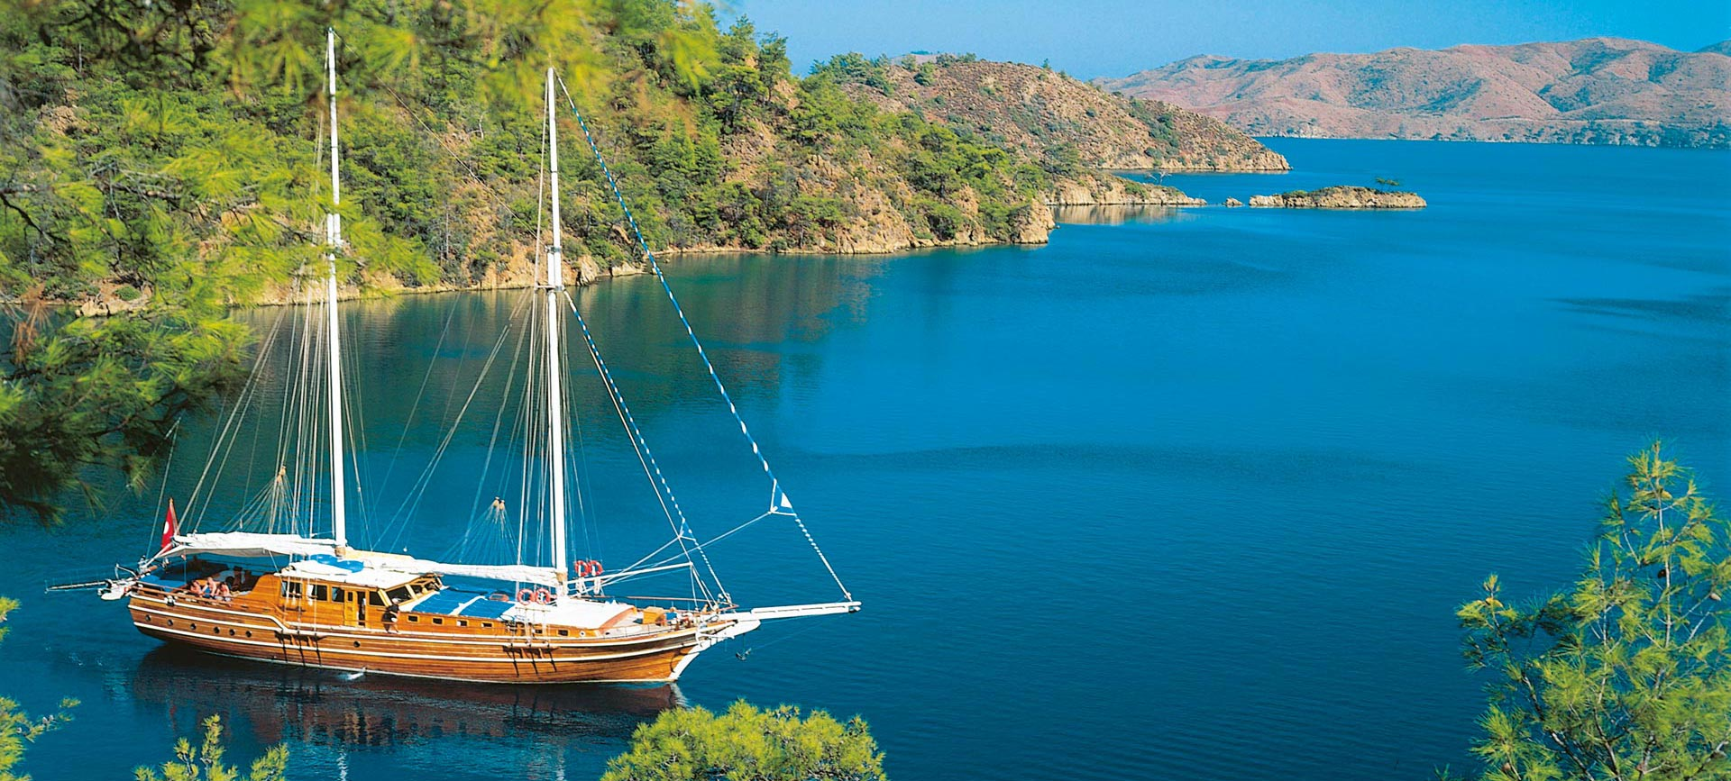

Slide 9
Blue Voyage:
Paker, Paker, 2016:
Today some of blue voyages are losing its purified sprit on discovery, and became a luxury voyage by presenting hedonic elements to customers

Slide 10
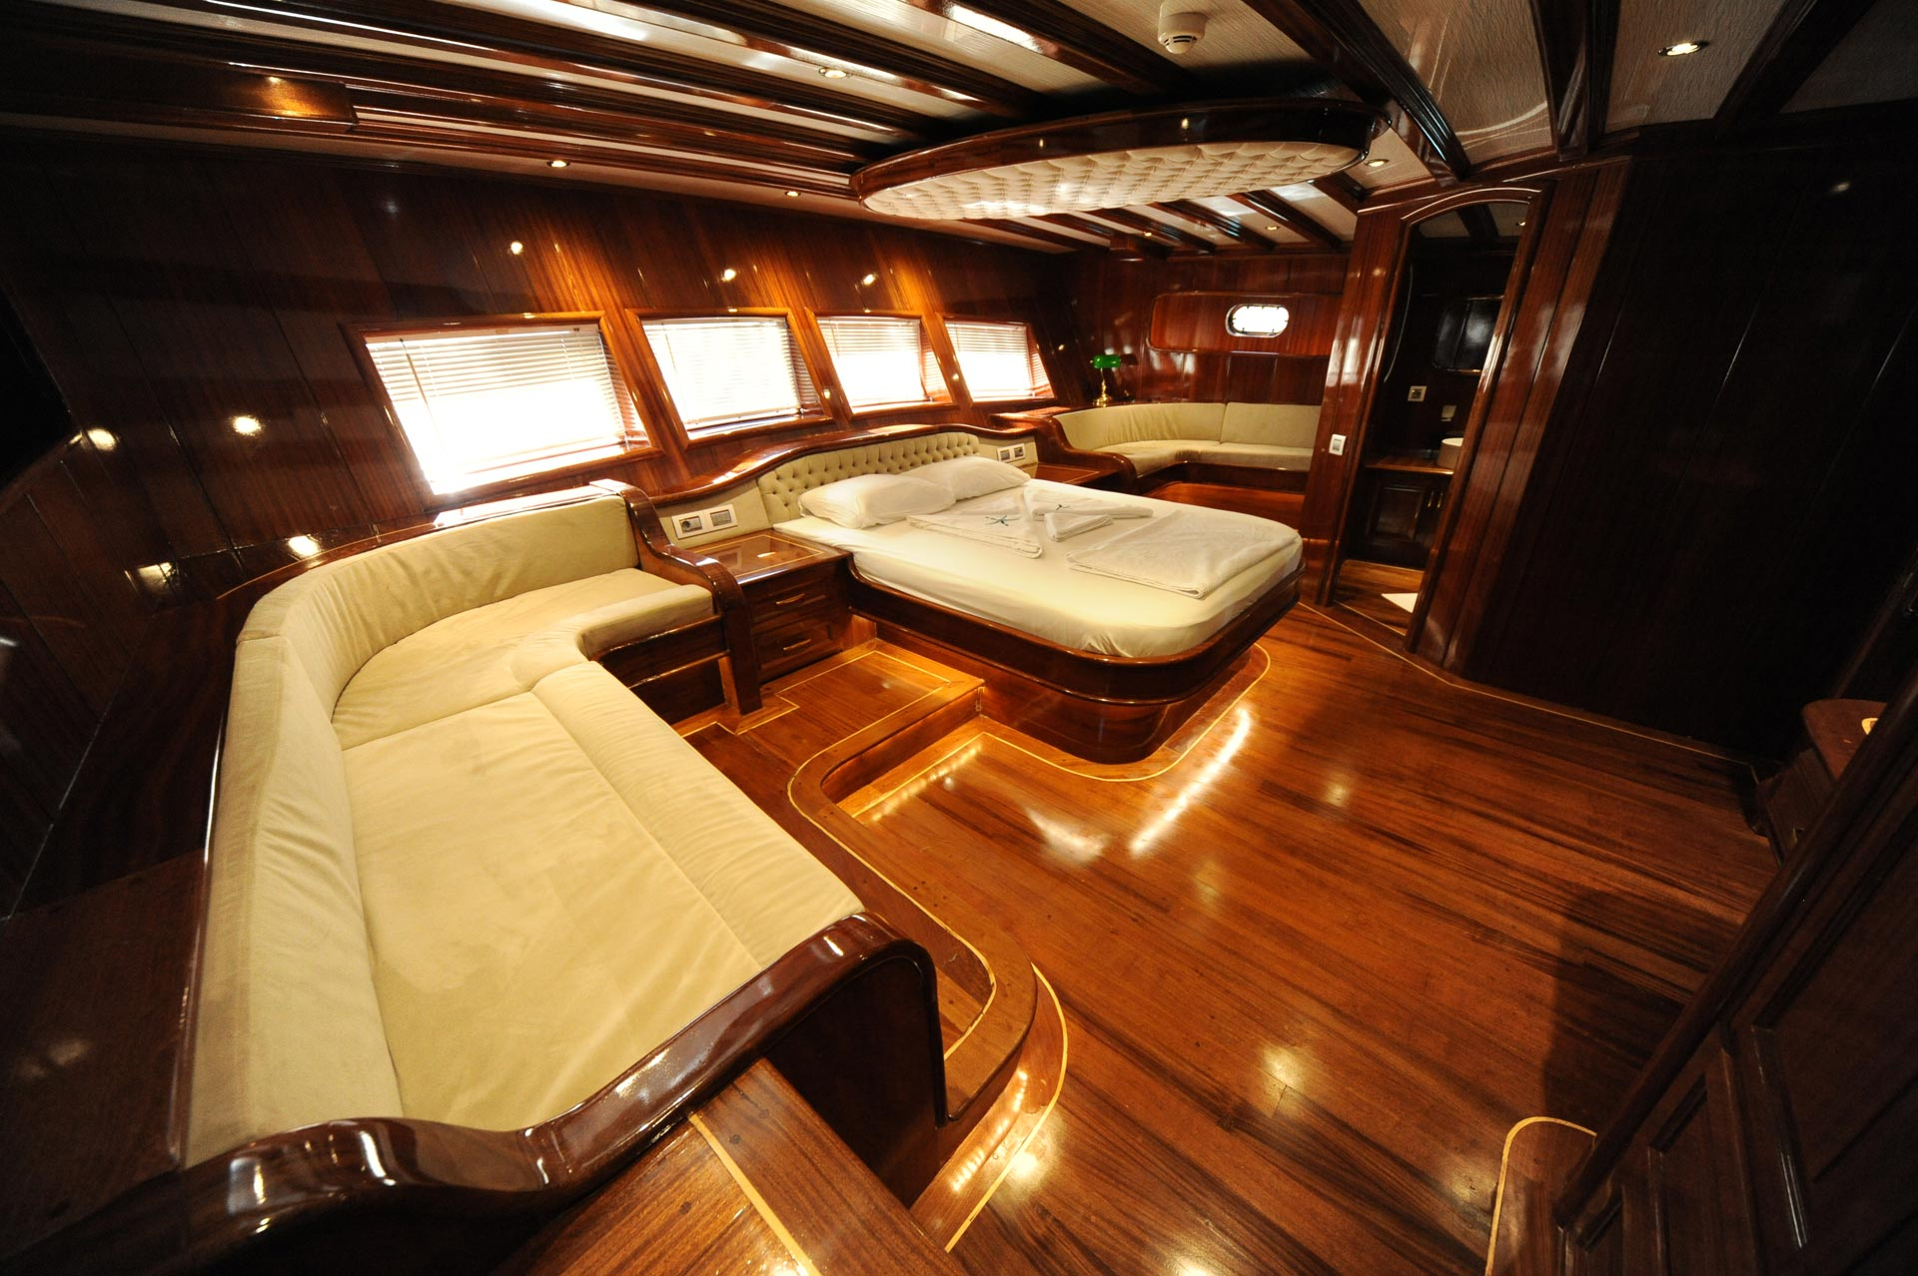

Slide 11
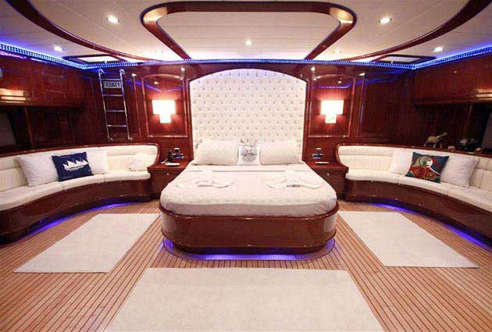

Slide 12
Buying Intention
Demir, 2010, Kotler and Keller, 2012 :
The buying process is beginning with problem recognition, namely buying intention, which regards motivation factors.
The other steps, research information, evaluating alternatives, and the taking purchase decision, follow that initial step regarding buyer’s expectation towards product/ service, and his/her limitations

Slide 13
Hedonic Buying Motivations:
Kazakeviciute and Banyte, 2012 :
Hedonic buying is mostly focused on buying process rather than buying decision.
Most important part is getting enjoy or fun, feeling happy while occurring that process.
It doesn’t entail buying a hedonic product, moreover, in some cases, even buying a product is not necessary.

Slide 14
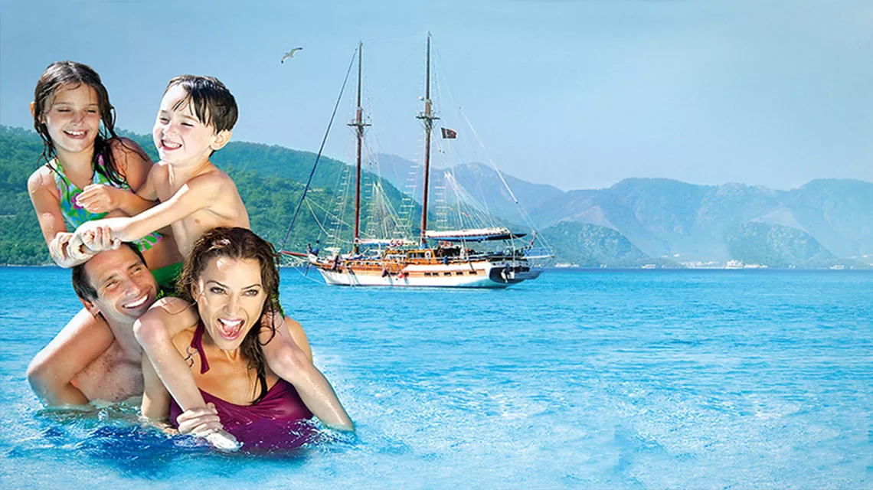
Hedonic Buying Motivations :
The most obtained hedonic buying motivations;
Babin et al., 1994 :
Entertaining, escaping/relaxing, thinking free, satisfying need of self-esteem
Arnold and Reynold, 2003 :
Living adventure, getting relieve, being social, treat myself to something special, making pleasant to the others

Slide 15
Push Factors (Motivations) :
Baloğlu ve Uysal, 1996 :
According to destination marketing frame, a tourist is directed any place by motivating some factors.

Slide 16
Push Factors (Motivations) :
Being free (Yooshik ve Uysal, 2005; Demir, 2010; Hung ve Petrick, 2011),
Having fun (Yooshik ve Uysal, 2005; İçöz, 2013),
Escape from routine (Yooshik ve Uysal, 2005; Hsu,Tsai,and Wu, 2009; Demir, 2010; İçöz, 2013),
For health and fitness (Yooshik and Uysal, 2005; Hsu,Tsai,and Wu, 2009 ; İçöz, 2013),
Meet different culture and lifestyles (Yooshik ve Uysal, 2005; Hung and Petrick, 2011; İçöz, 2013),
Rediscover myself (Yooshik ve Uysal, 2005).

Slide 17
Research Design and Methodology

Slide 18
Research Question:
Which motivation factors are behind of blue voyage buying intention?

Slide 19
Research Hypothesis
H1: Purchase intention of blue voyage is effected by push factors
H2: Purchase intention of blue voyage is effected by hedonic buying motivations

Slide 20
Questionnaire Development
 |  | Category of the Motivation
Questionnaire Scale Items | Sources of the Scale | Hedonic Buying Motivations | Push Factors
Escape from routine | Babin et al., 1994; Yooshik and Uysal, 2005; Hung and Petrick, 2011 | X | X
Being free to act how I feel | Babin et al., 1994; Yooshik ve Uysal, 2005; Hung and Petrick, 2011 | X | X
For health and fitness | Yooshik and Uysal, 2005 |  | X
Having fun | Babin et al., 1994; Yooshik and Uysal, 2005 | X | X
Meet different cultures and life styles | Yooshik and Uysal, 2005; Hung and Petrick, 2011 |  | X
Get social recognition | Hung and Petrick, 2011 |  | X
Rediscover myself | Yooshik ve Uysal, 2005 |  | X
Satisfy my need of self-esteem | Babin et al., 1994; Hung and Petrick, 2011 | X | X
Live an adventure | Arnold and Reynold, 2003; Yooshik and Uysal, 2005 ; Hung and Petrick, 2011 | X | X
Make me feel like I am in my own universe | Arnold and Reynold, 2003 |  | X
Make me feel better when I’m in a down mood | Arnold and Reynold, 2003 | X
Relieve my stress level | Babin et al., 1994; Arnold and Reynold, 2003; Hung and Petrick, 2011 | X | X
Treat myself to something special | Arnold and Reynold, 2003 | X
I join blue voyage for others because when they feel good I feel good | Arnold and Reynold, 2003 | X
Being with my friends or family to socialize | Arnold and Reynold, 2003; Yooshik and Uysal, 2005; Hung and Petrick, 2011 | X | X
Bonding experience with others | Arnold and Reynold, 2003; Hung and Petrick, 2011 | X | X
Increase knowledge | Arnold and Reynold, 2003; Yooshik and Uysal, 2005; Hung and Petrick, 2011 | X | X
See new places | Yooshik and Uysal, 2005 |  | X
Visit historical and cultural places | Yooshik and Uysal, 2005 |  | X
Feel safe | Yooshik and Uysal, 2005 |  | X
Feel secure | Yooshik and Uysal, 2005 |  | X
Feel at home away from home | Yooshik and Uysal, 2005 |  | X

Slide 21
Sampling Process
This survey is designed as a pilot study, and it was applied on 42 respondents.
Non-probable purposive sampling approach was used
The respondents ; past experience and/or knowledge on blue voyage or willingness to participate to blue voyage, answer the questionnaire in English,
It is a self-administered questionnaire

Slide 22
Design of Questionnaire
Descriptive variables; such as age, gender, income level, and behavioral variables such as blue voyage experience.
Scale variables; independent variables: hedonic buying & push motivations
Dependent variable; buying intention ragerding those motivations
An open-question part to learn additional comments of respondents and to interpret result more effective.
Continuous type scale; a 7-point Likert scale where 1 = “Strongly Disagree” and 7 = “Strongly Agree”.

Slide 23
Findings and Discussion

Slide 24
Profile of The Sample

Slide 25
Individual Motivations for Blue Voyage

Slide 26
Purchase Intention Regarding Motivation Factors
1 = “Strongly Disagree” and 7 = “Strongly Agree

Slide 27
Factor Analyzing Based on Individual Motivations for a Blue Voyage Intention
Factors | Mean of factor | Eigen Value | % of variance | Cumulative % | Cronbach’s Alpha
Relaxing | 5.1 | 3.04 | 20.3 | 20.3 | 0.817
Exploring | 4.3 | 2.3 | 15.1 | 35.3 | 0.647
Adventure | 5.6 | 1.9 | 12.5 | 47.9 | 0.644
Socializing | 4.8 | 1.8 | 12.2 | 60.1 | 0.787
Making a gift | 4.4 | 1.4 | 9.4 | 69.4 | 0.322
General |  |  |  |  | 0.813
Rotated varimax method was used to rotate factors, and factors with eigenvalues greater than one were retained.
Two variables were removed because of high correlation.
Five variables were eliminated because of double loaded into different factors

Slide 28
Regression Analysis based on Individual Motivations for a Blue Voyage Tour Intention- Model summary for purchase intention
R | R Square | Adjusted R Square | Std. Error of the Estimate | Durbin-Watson
.682ª | .466 | .414 | .808 | 1.503
-Relaxing and socializing factors were removed since they were not found statistically significant for the model
6 observations were detected as influential observations with high leverage in the model. They were deleted from the analysis.
Multi regression assumptions are checked; linearity, normality, multi collinearity.

Slide 29
Model summary for purchase intention- ANOVA
ANOVAª
Model |  | Sum of Squares | df | Mean Square | F | Sig.
 | Regression | 17.641 | 3 | 5.880 | 9.004 | .000^{b}
 | Residual | 20.245 | 31 | .653
 | Total | 37.886 | 34

Slide 30
Model summary for purchase intention-Coefficient of factors
Coefficientsª
Model |  | Unstandardized Coefficients |  | Standardized Coefficients | t | Sig. | Collinearity Statistics
 |  | B | Std. Error | Beta |  |  | VIF
 | (Constant) | 5.495 | .141 |  | 38.987 | .000
 | BART factor score Exploring | .364 | .156 | .308 | 2.334 | .026 | 1.007
 | BART factor score Adventure | .648 | .171 | .504 | 3.784 | .001 | 1.030
 | BART factor score Making a gift | .444 | .154 | .383 | 2.882 | .007 | 1.022
a. Dependent Variable: Purchase intention

Slide 31
Model summary for buying intention
Buying intention= 5.495+0.364*Exploring+0.648*Adventure+0.444*Making a Gift
Visit historical and cultural places
Meet different cultures
For health and fitness
Get social recognition
Escape from routine
Live an adventure
Treat myself to something special
I join blue voyage for others because when they feel good I feel good

Slide 32
Moderator Detection for Regression Model
Moderator 1: Exploring*Adventure,
Moderator 2: Exploring *Making a Gift ,
Moderator 3: Adventure* Making a Gift.
All results for p-value of moderator have been calculated above 0,05.
There was not found any moderator effect in the model

Slide 33
Mediation Analysis for Regression Model
Simple regression; between all variables in the received model and purchase intention.
Simple regression analysis among independent variables.
No significant relationship was observed.
As a result, no mediator effect has been found in the model.

Slide 34
Hypothesis Evaluation for the research
 |  | Category of the Motivation
 | Factors | Hedonic Buying Motivations | Push Factors | Related Hypothesis | Hypothesis Evaluation
Escape from routine | Adventure | X | X | H1 & H2 | Not Rejected
Live an adventure | Adventure | X | X | H1 & H2 | Not Rejected
For health and fitness | Exploring |  | X | H1 | Not Rejected
Meet different cultures and life styles | Exploring |  | X | H1 | Not Rejected
Get social recognition | Exploring |  | X | H1 | Not Rejected
Visit historical and cultural places | Exploring |  | X | H1 | Not Rejected
Treat myself to something special | Gifting | X |  | H2 | Not Rejected
I join blue voyage for others because when they feel good I feel good | Gifting | X |  | H2 | Not Rejected

Slide 35
Suggestions for Practitioners :
publicity and promotions focusing on adventure, exploring, and making a gift
Having fun, see new places, escape from routine, and feel free elements should be considered as important tools for enhancing customer satisfaction.
The blue voyage has been perceived as a deserved gift. Thus, it should be presented as a special and valuable prize by creating a hedonic ambiance in the yacht.
Word of mouth importance
Social media should be used more efficiently promoting adventure and hedonism sprit.
Blue voyage is a touristic product which should be presented in a hedonic ambiance.

Slide 36
Limitations: Sample size / Questionnaire language / Nonprobable purposive sampling
Suggestions for Future Studies:
Conceptual aspects of the blue voyage
Characteristics of blue voyage product as pull factors, and evaluation of alternative services provided considering customer characteristics such as cultural dimensions.
Following steps related with purchase decion of a blue voyage
Daily tours
Segmentation analysis for having different motivations and expectation of a blue voyage tour

Slide 37
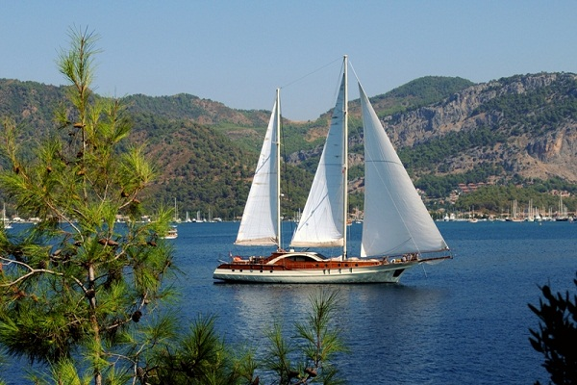
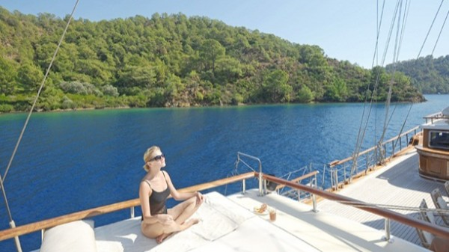
THANKS
Neslihan PAKER – Yaşar University-pakerneslihan@gmail.com
Serim PAKER- Dokuz Eylül University-serim.paker@deu.edu.tr

