Slide 1


Exploring the Cultural Animosity of German-Turks: A Comparison of Generations
Özge ÖZGEN, Ph.D
Pınar BAĞDATLIOĞLU
Dokuz Eylül University, Faculty of Business
Department of International Business and Trade

Slide 2
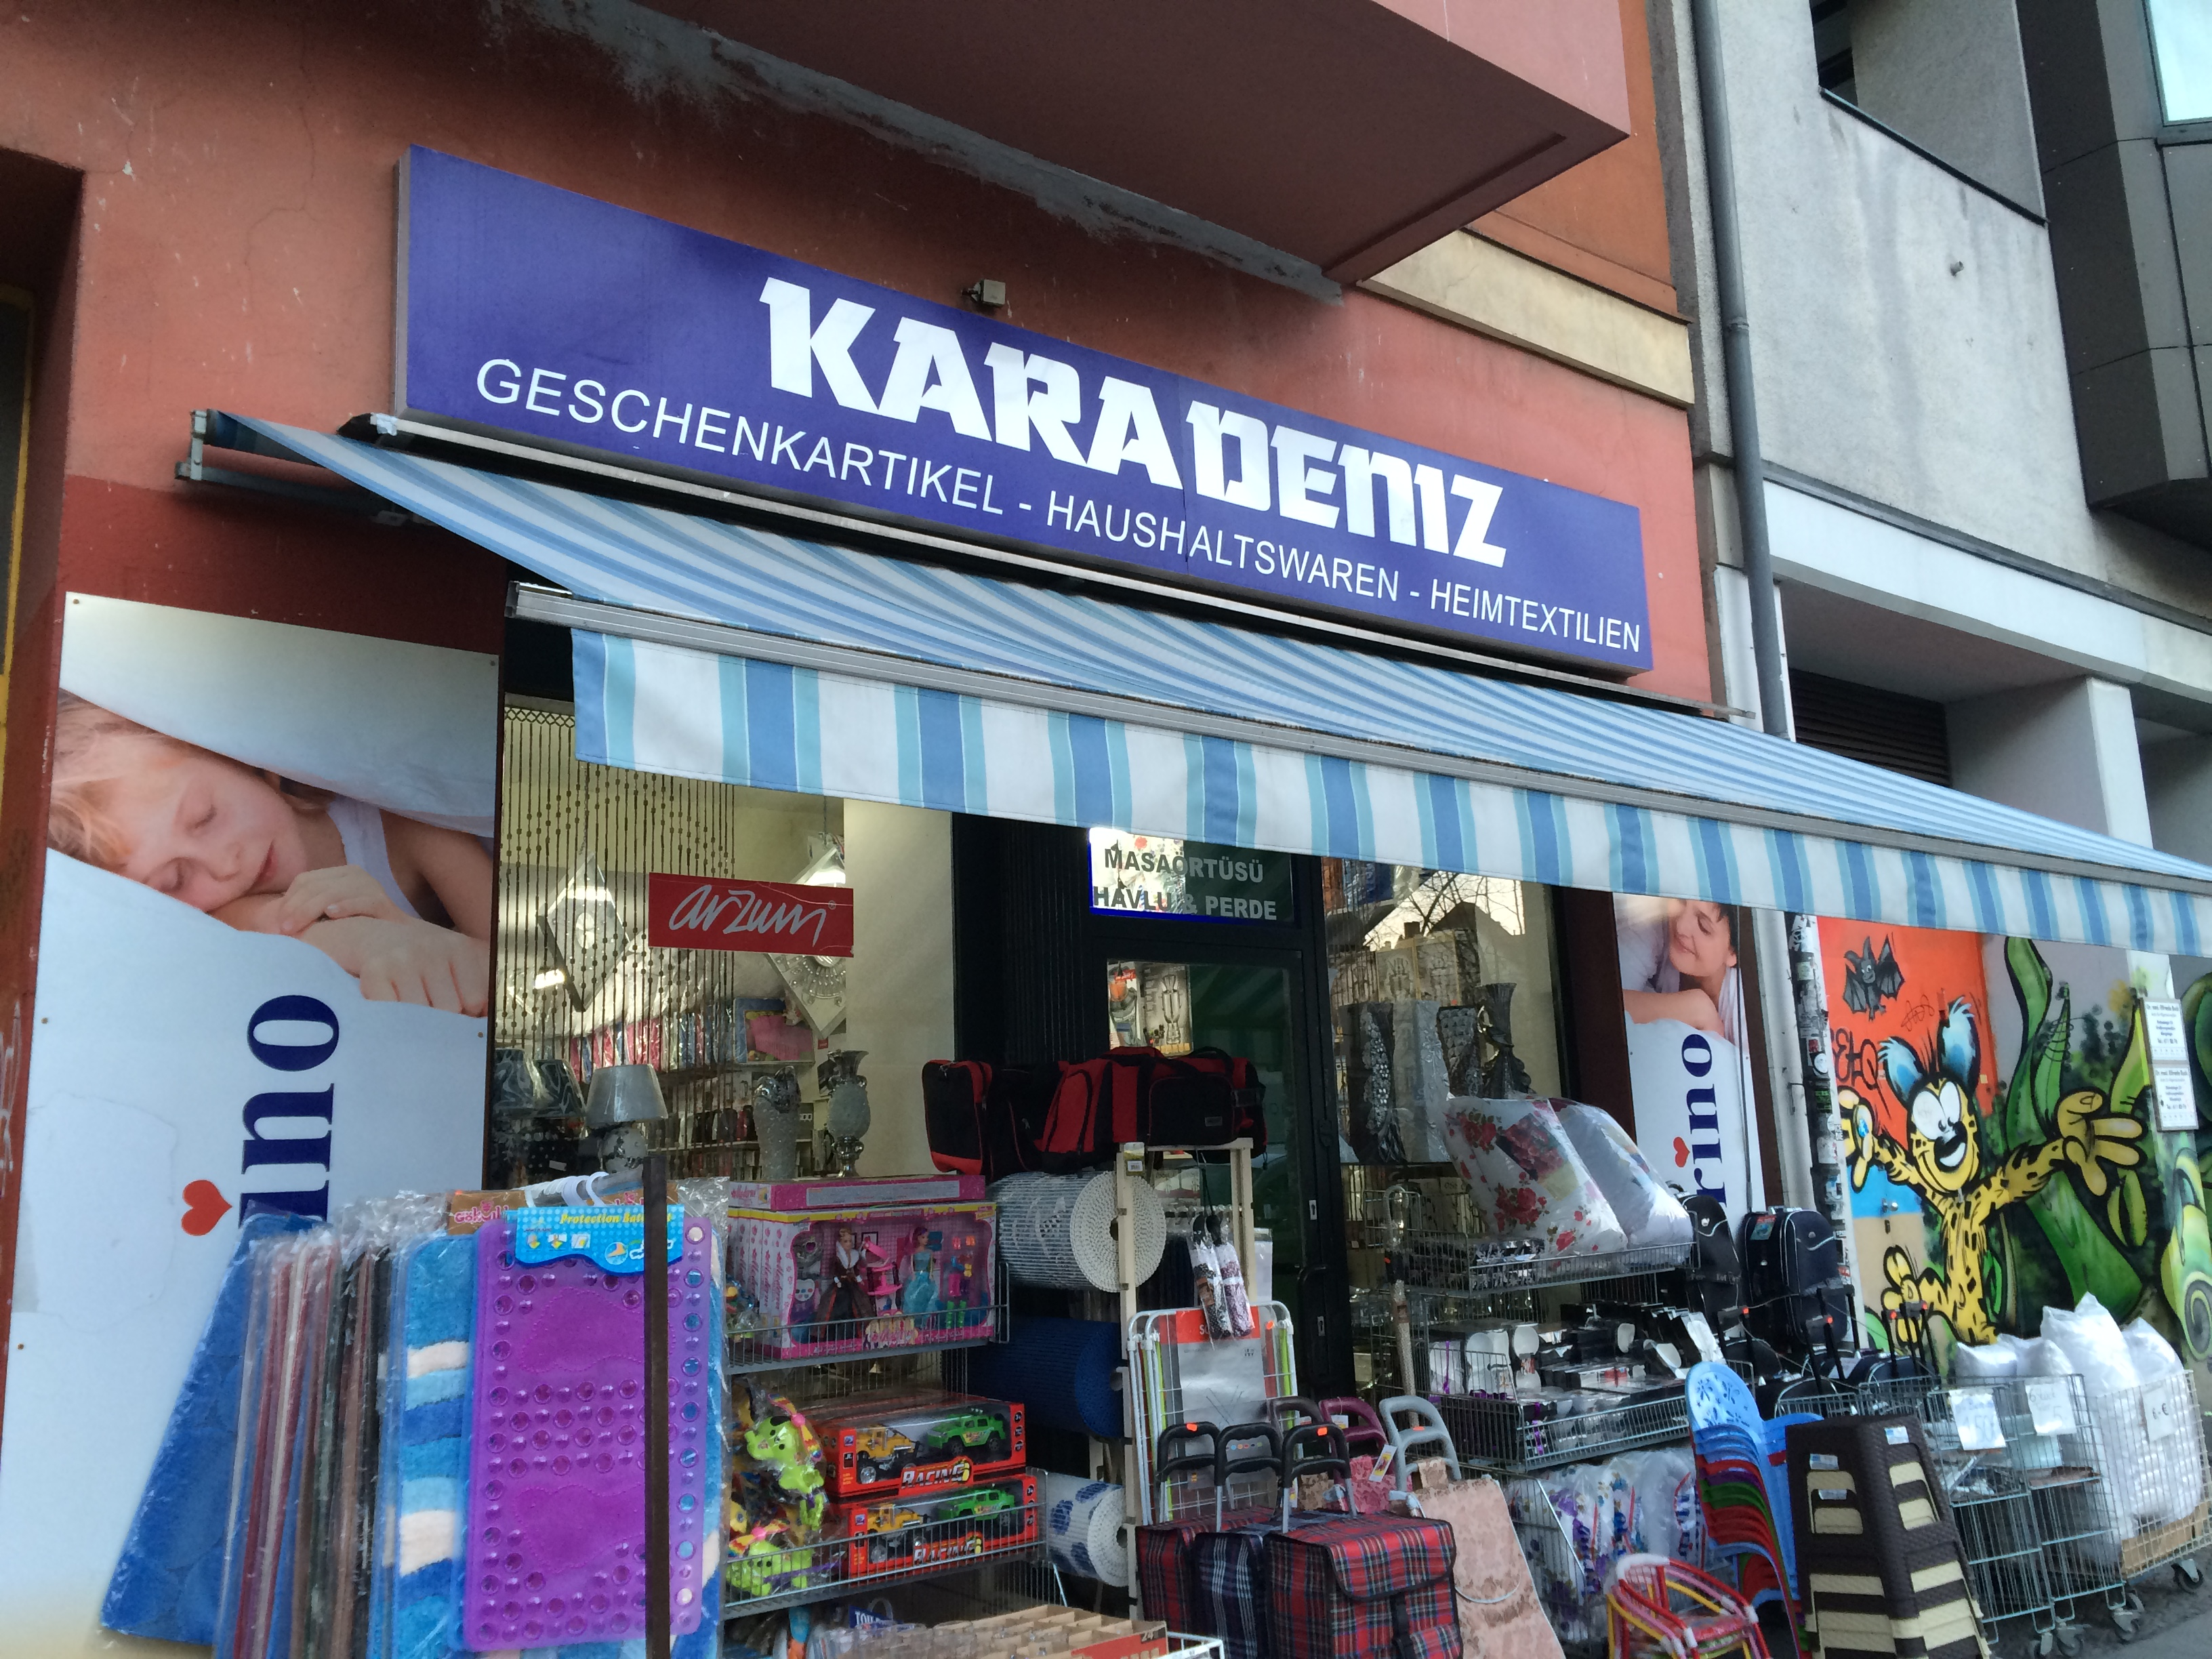
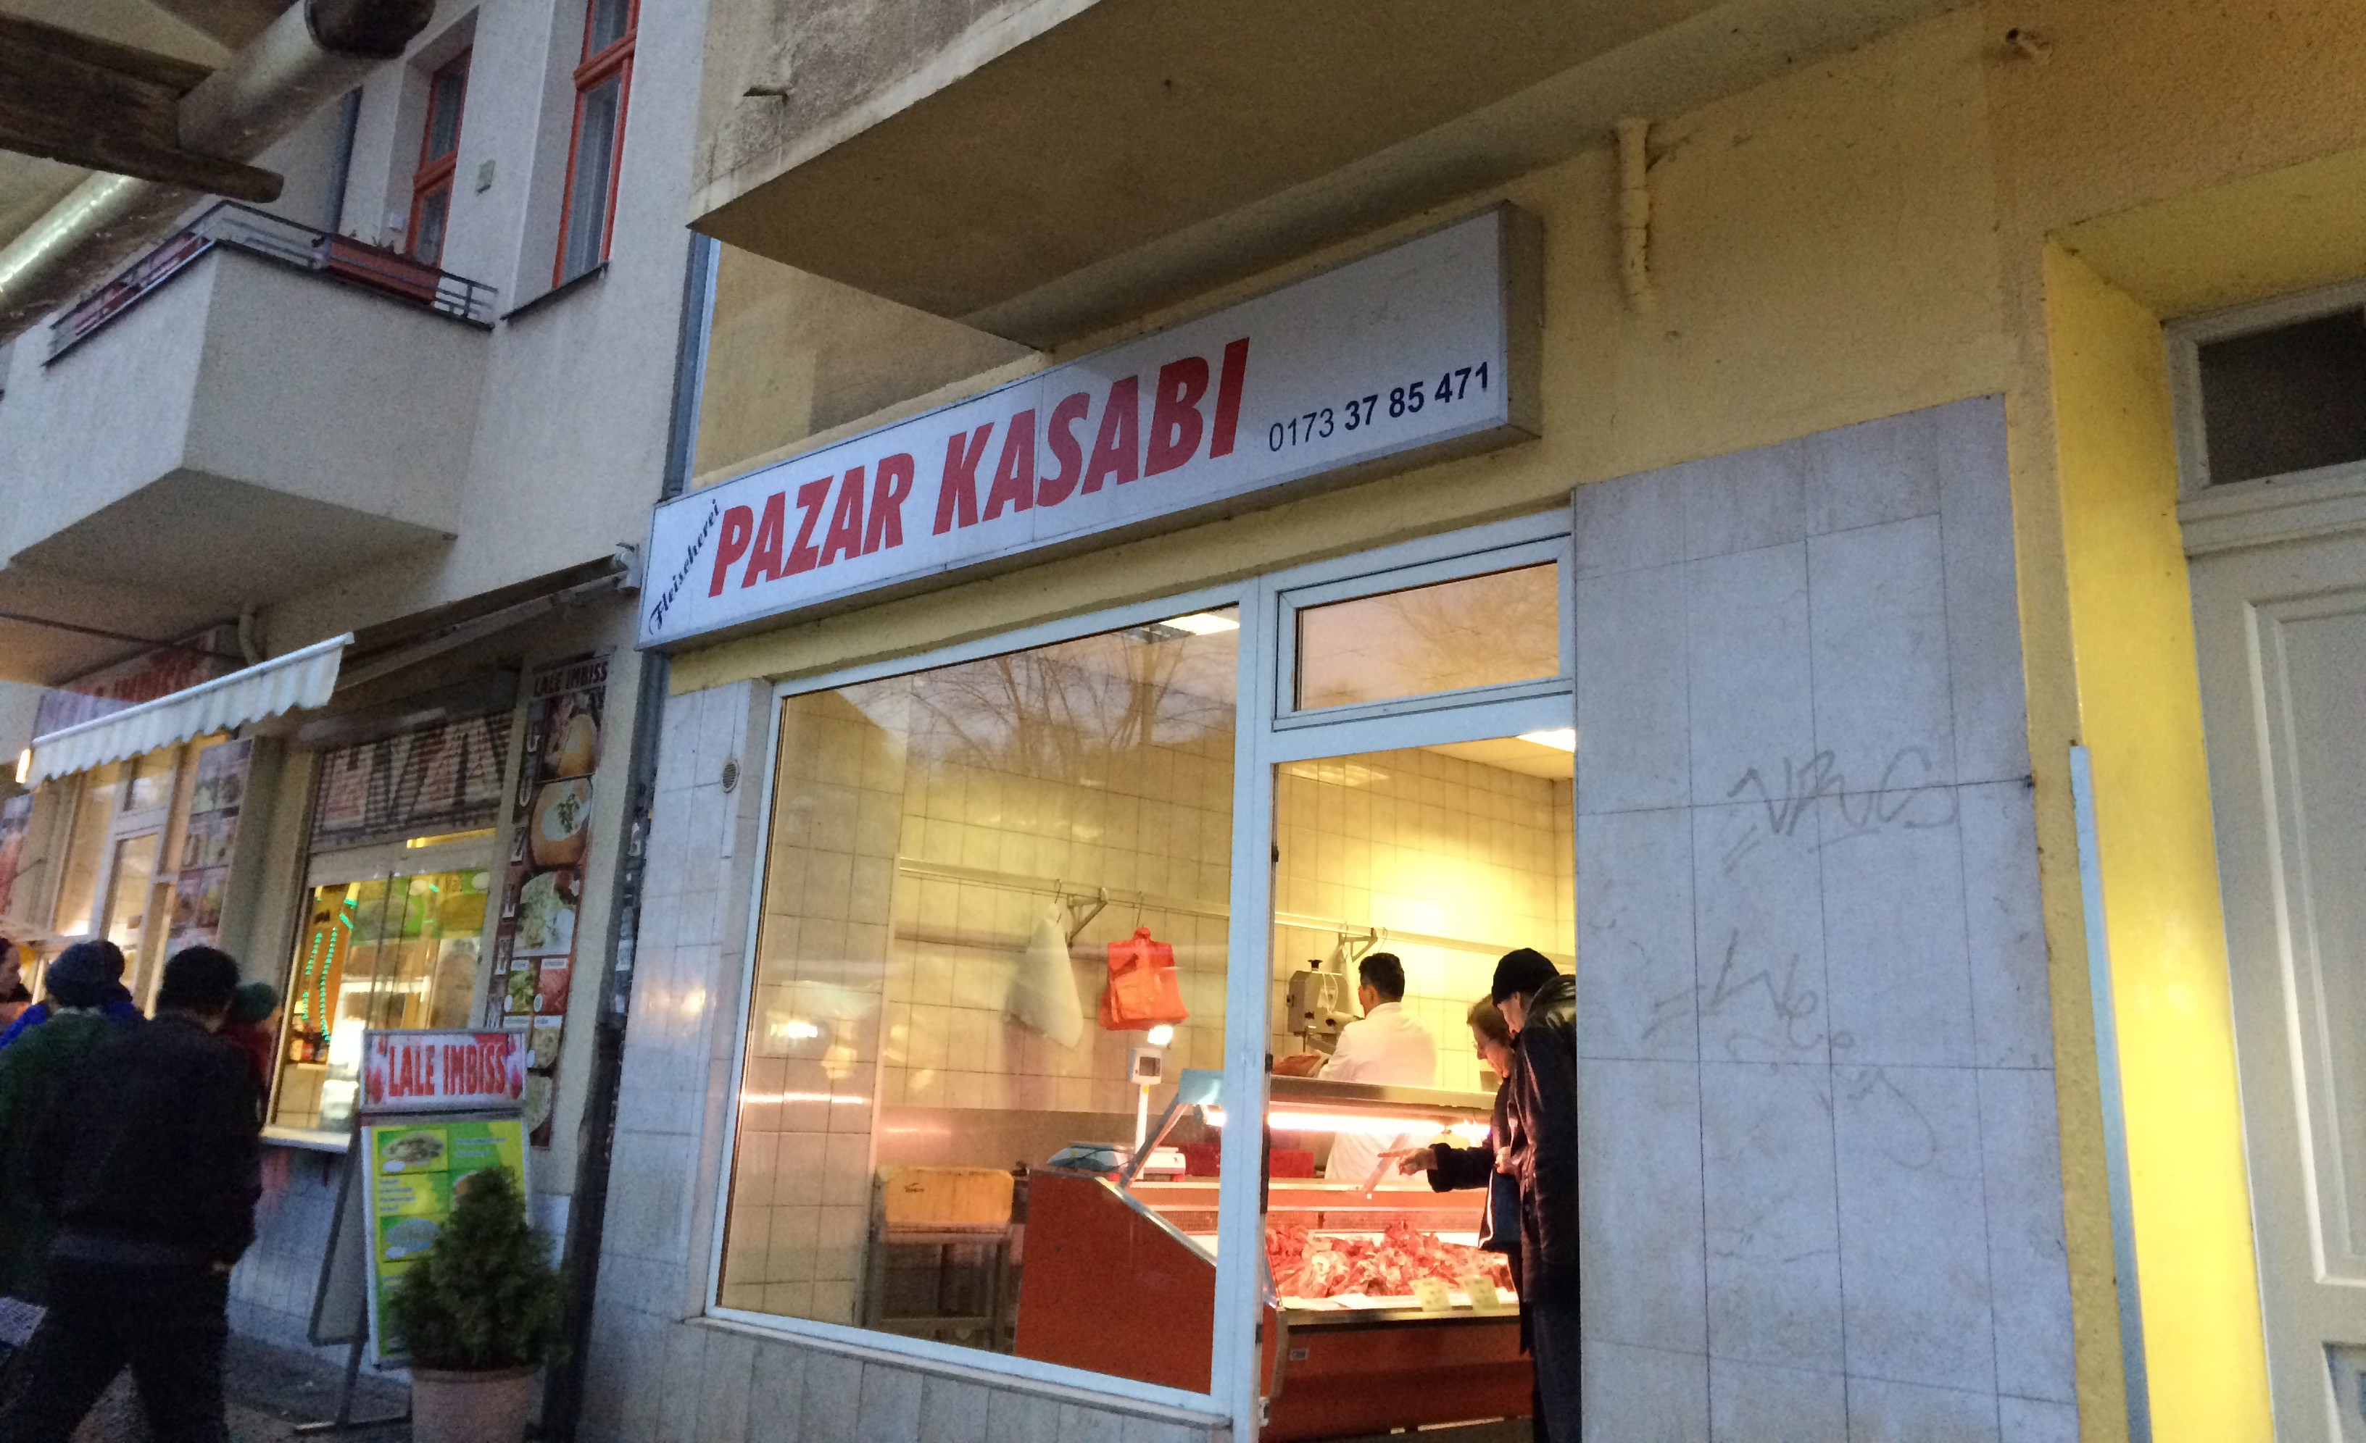
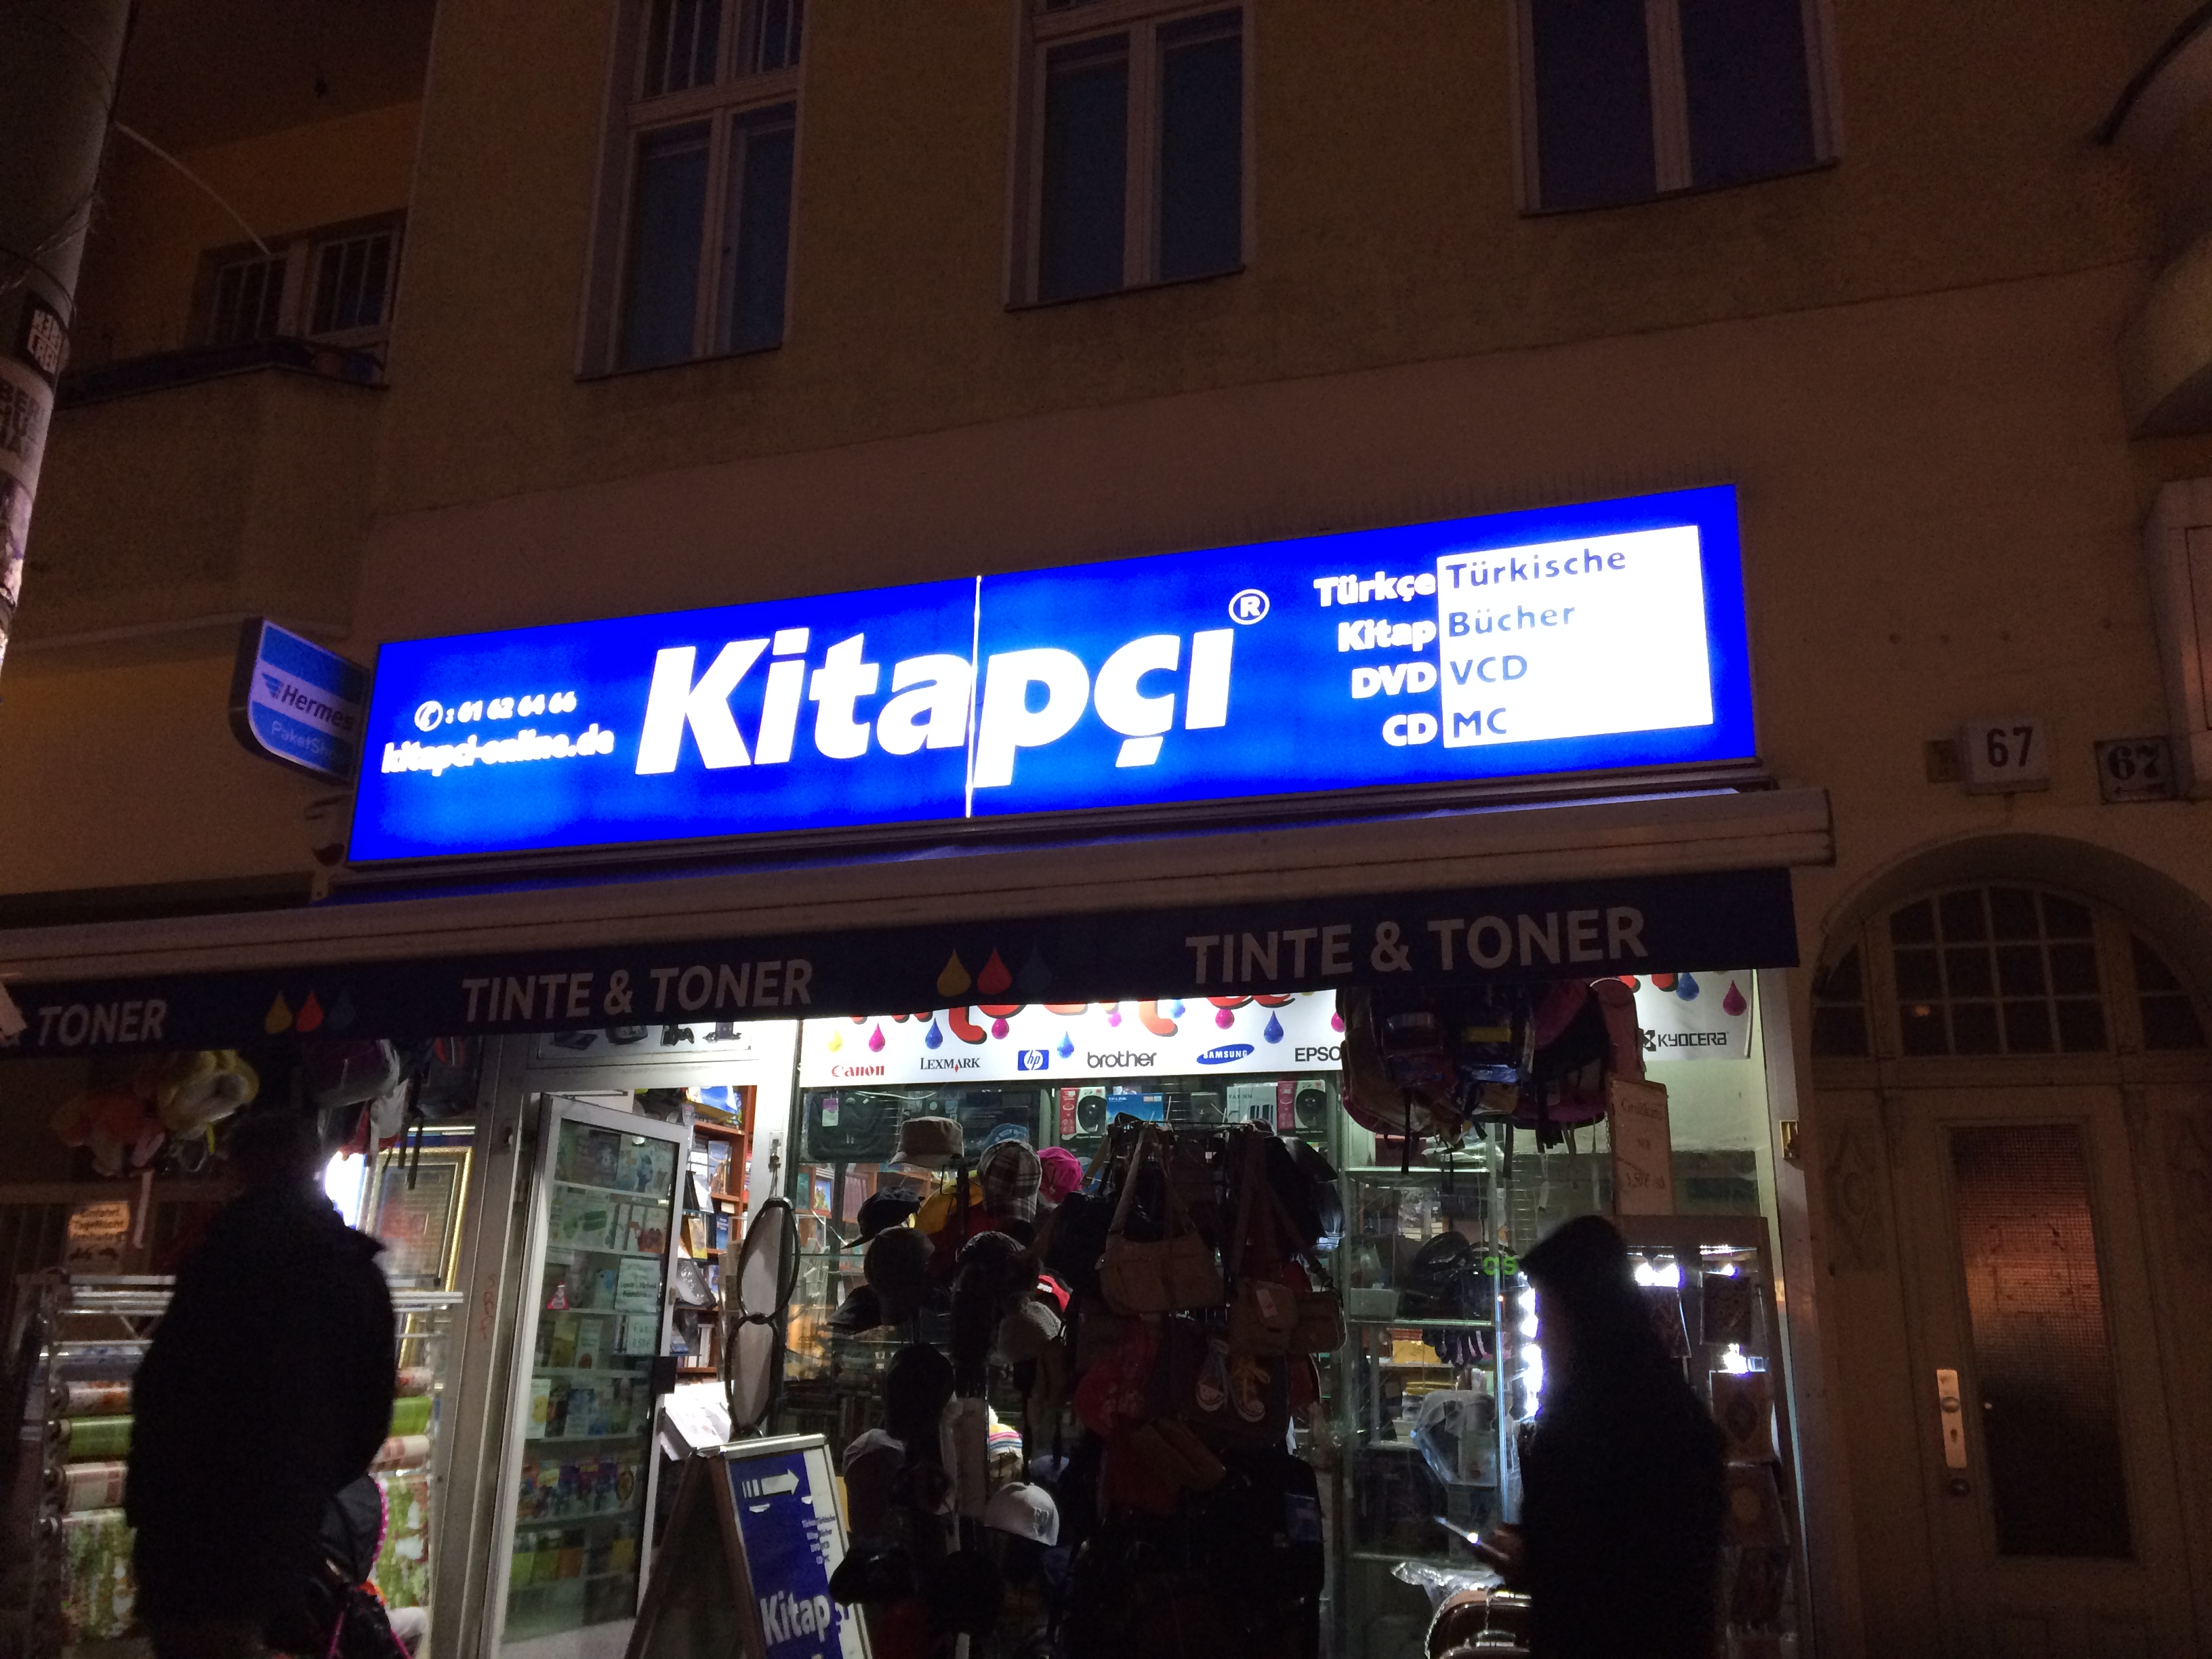
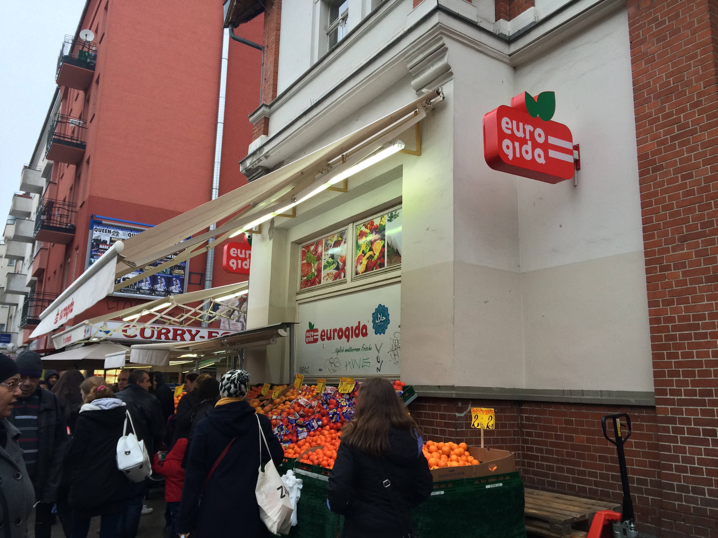
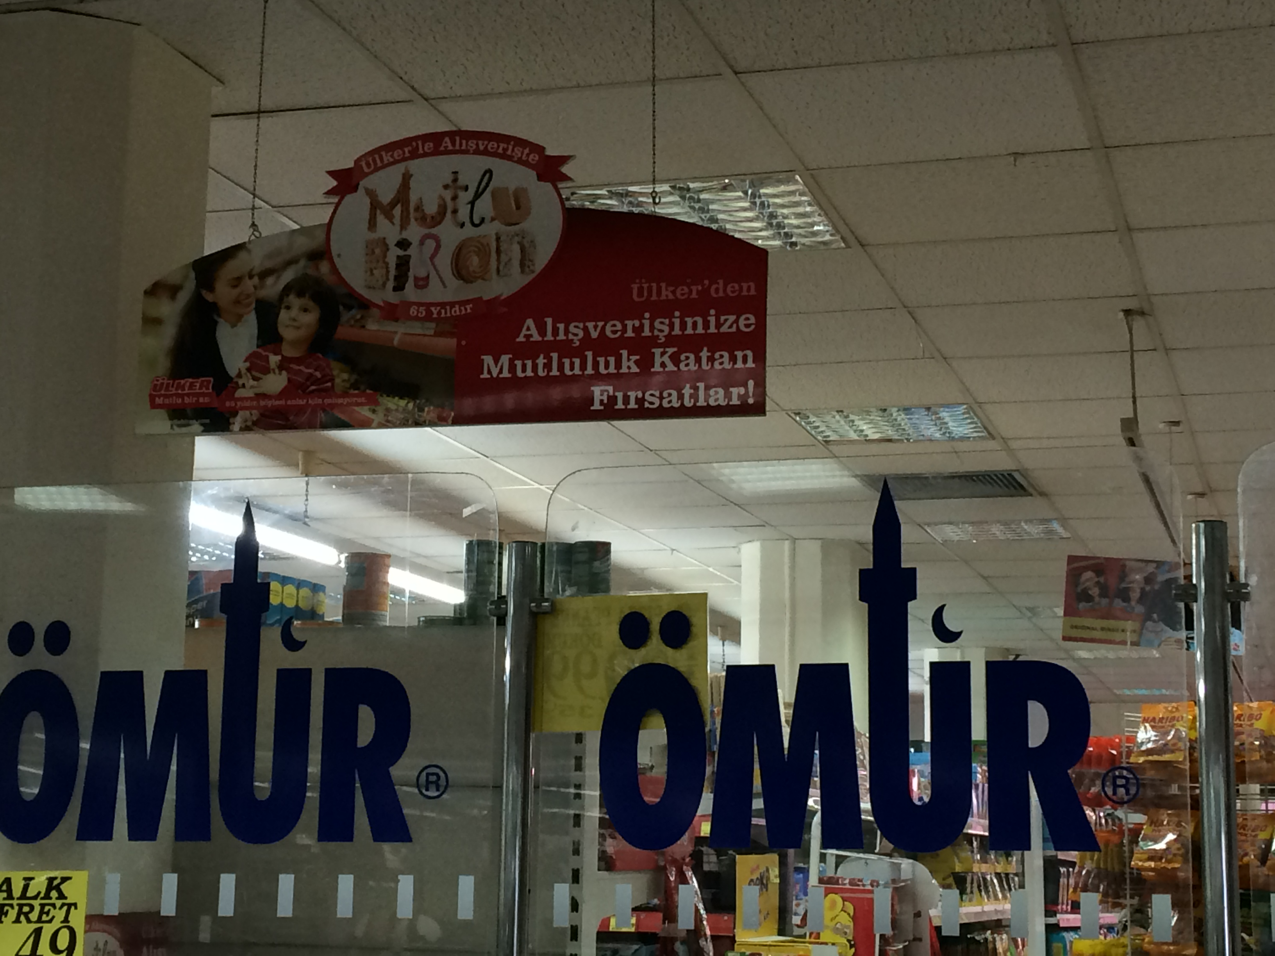
Content
Literature review
Objective of the study
Methodology
Findings
Conclusion

Slide 3

Animosity
“the remnants of antipathy related to previous or ongoing political, military, economic events” (Klein, Ettenson and Morris, 1998, p. 90)
Dimensions of animosity
Economic based (Ang et al., 2004; Shin, 2001),
War based (Klein, 2002; Nijssen and Douglas, 2004),
Political and diplomatic based (Bahaee and Pisani, 2009; Nes, Yelkur and Silkoset, 2012)
A great deal of research has focused on the animosity among countries (Bahaee and Pisani, 2009; Fernández-Ferrín et al., 2015)

Slide 4

Gaps in the Animosity Literature
Considerably less study related to
influence of culture on consumer animosity
(Darrat, 2011; Kalliny, Hausman and Saran, 2015; Riefler and Diamantopoulos, 2007)
animosity among different ethnic groups or between immigrants and native-born citizens
Little and Singh (2014)
the association between animosity and generational differences
(Little et al., 2009)

Slide 5

Objective of the study
exploring the nature of animosity and particularly cultural animosity of a minority group towards native-born citizens of the country, and comprehending its impact on buyer preferences

Slide 6
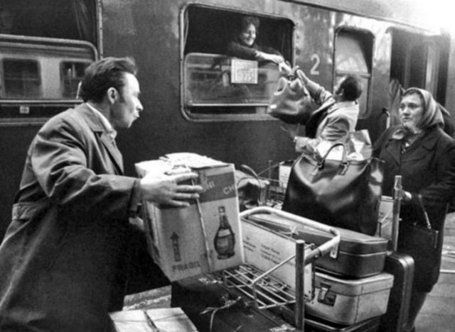
Subjects of the study
German-Turks (Turkish immigrants living in Germany)
2.7 million people with Turkish origin are living in Germany.
3 percent of the total population
The largest minority group in Germany
Average monthly household income 3,980 Euro.
Notes:
the first generation → first arrivals from Turkey (typical guest-workers)
They were mainly less educated and unskilled workers without any specific profession (Sen, 2003).
The second generation, children of the first generation, has better education, professional status, language skills and defend their rights distinctly which strengthens their integrity levels in socio-political environment (Sen, 2003).
The third generation, grandchildren of guest workers, lives in their own bicultural world, where they still face the dilemma to follow Turkish and Islamic values, but also wishing to integrate into German society (Erdem and Schmidt, 2008).
Finally, the youngest generation, the fourth, was born in Germany and this generation is currently very young, so, they have not taken into consideration within this study.

Slide 7
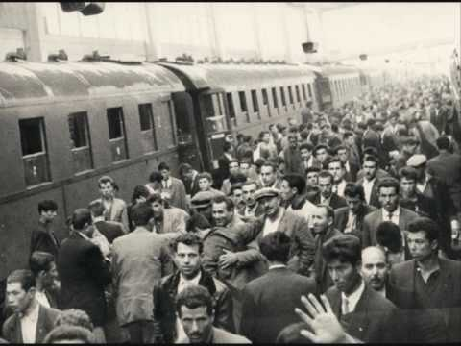
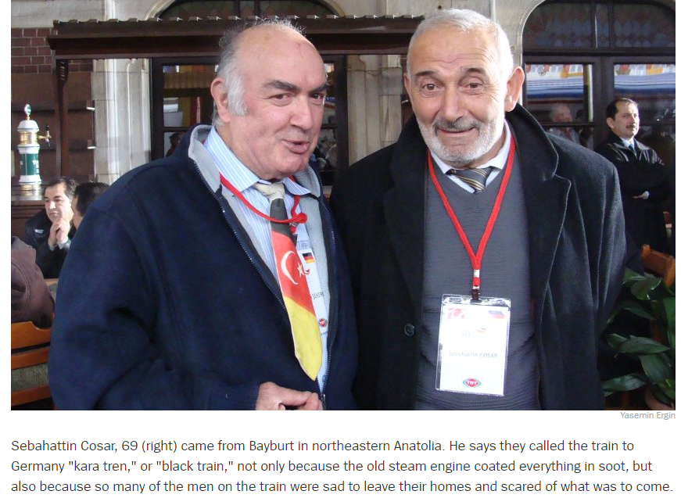
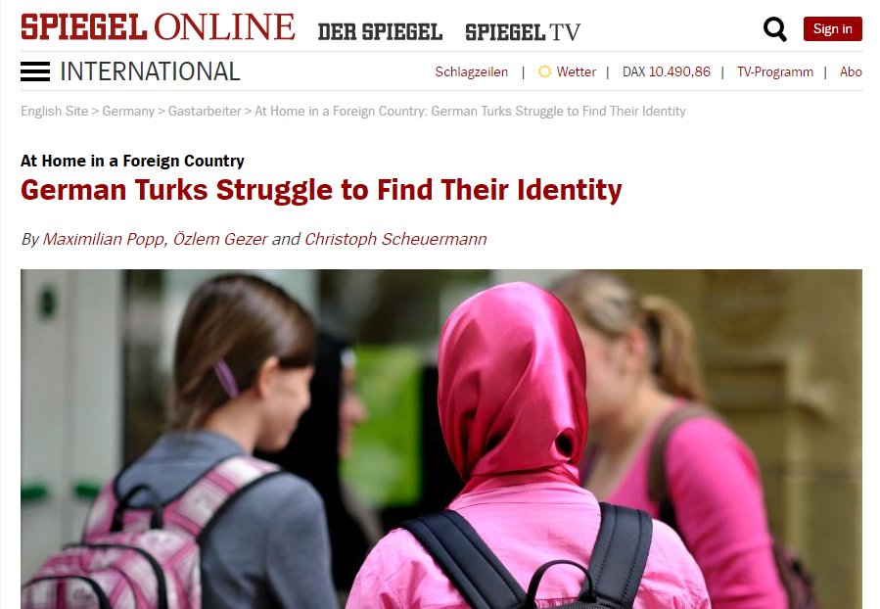
Subjects of the study
Four generations over 50 years of period
The first generation → first arrivals from Turkey (typical guest-workers)
Less educated and unskilled workers
The second generation → children of the first generation
Better education, professional status, language skills
Defending their rights
The third generation → grandchildren of guest workers
Living in their own bicultural world
Still face the dilemma to follow Turkish and Islamic values
The fourth, currently very young, (they have not taken into consideration within this study)

Slide 8

Research Methodology
Exploratory study
In-depth interviews
Snowball sampling
German-Turks living in Berlin
The largest Turkish population abroad (Approx. 200,000)
41 German-Turks
Equally split in terms of gender
10 respondents from the first-generation (Average Age: 67);
16 respondents from the second-generation (Average Age: 48)
15 respondents from the third-generation (Average Age: 26)

Slide 9
Indepth Interview
30-50 minutes (audio-recorded by getting permission)
Semi-structured- Examples of questions
“What is animosity?”
“Do you have animosity toward Germany/Germans?”
“If yes, what are the reasons behind your animosity?”
“Do you think that your animosity has an effect on your purchasing decision? How?”
Content analysis
Unit of analysis → Themes (suggested as the most useful unit of content analysis by Kassarjian (1977))

Slide 10
FINDINGS

Slide 11
The concept of animosity
The concept of animosity was defined with
emotional terms from conflict, resentment, anger, and grudge to hostility in different emotional intensity ranges
First-generation avoid using very strong negative emotional terms
The respondents from second-generation refer specifically to the grudge.
For example, Hatice (female, second-generation) mentions the term of “blood feud” when she attempts to explain the animosity.

Slide 12
Third generation have more animosity
For example, a male respondent from third generation mentions that he has already experienced the discrimination when he is looking for a job:
“For two years, I harbored animosity towards Germans when I was looking for a job. I applied everywhere but no one called, because there was a foreign name on my CV. However, I was born here and I am a German citizen.”

Slide 13
German-Turks tend to have the personal and situational animosity
The animosity feelings of German-Turks toward Germans are mostly originated from specific and current
Not deeply rooted and are not transmitted from one generation to the next.
Verbatims of two generations from the same family:
“I hold animosity toward some Germans, because they obviously don't like you and don't want you in Germany. I'm living in a small town and especially old people treat you differently there, although I am always polite to them.” (Burcu, female, third-generation)
“Why do I need to have animosity towards Germans? We are living in their homeland and we should be respectful.” (Hale, mother of Burcu, female, second-generation)

Slide 14
More Responsive to the Raising Presence of Xenophobia and Islamophobia
For example, the following respondent’s (Murat, male, third-generation) verbatim sentences show his impression related to xenophobic discourses as the reason underlying behind his animosity:
“In general, I only have animosity towards Germans who are xenophobic. There are at least 3-5 million foreign people in Germany. However, Germans call only Turkish and Arabic immigrants as foreigners, because we are Muslim.”
Young German-Turks are becoming more nationalistic and radical :
“The radicalization of the Turkish youth is the output of Germany, not just from their own families. The feeling of social exclusion makes them more radical.” (Ender, male, second-generation)

Slide 15
The Antecedents of Animosity: Discrimination, Socio-cultural Differences and Maltreatment
For example, Bilge (female, third-generation) harbor animosity due to the religious prejudice of Germans against Islam:
“Germans show negative reactions when they see a woman wearing a headscarf. This is not about being Turkish; they have a fear of Islam. Religion is a topic that we cannot keep quiet about. I may be more radical than my relatives about this.”

Slide 16
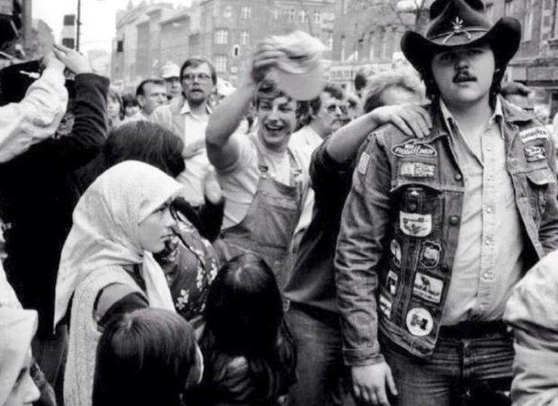
Perception about Cultural Superiority
Most of the respondents perceive Turkish culture as superior
“Many of the Germans that I know are atheist. In general, they have small families with one child. They are not as hospitable as Turkish people. These are negative things. I have grown up in both cultures and German culture seems to be much more negative.” (Duygu, female, third-generation)
German culture → a threat for a change in Turkish culture
The fear of losing ties with owns culture
“In my opinion, there is a negative interaction between two cultures. While we are integrated to German culture, we destroy our own culture. We need to keep alive Turkish culture.” (Mustafa, male, second-generation)
1984-During a Festival in Germany

Slide 17
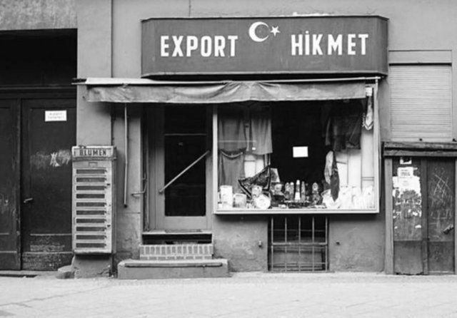
No severe influence on buying preferences
“I may quit purchasing French or American products but not German, since I am living in Germany. I cannot imagine this!” (Mustafa, male, second-generation),
“Sometimes I harbor animosity toward Germans but not that much to avoid purchasing German products.” (Seda, female, third-generation)
1970s-Germany

Slide 18
Conclusion
The third-generation has more animosity.
The third-generation of German-Turks harbor specifically cultural animosity
Xenophobia and Islamophobia in German society increasingly trigger cultural animosity
The animosity has an implicit impact on consumption of German products.
Preference of German brands/stores (price, convenience, variety, quality advantages)
Purchasing German products is a necessity of living in Germany
Personal and situational animosity toward Germans
Not intense enough to influence consumption
However, the third-generation has a possibility to boycott German brands for a limited period of time

Slide 19
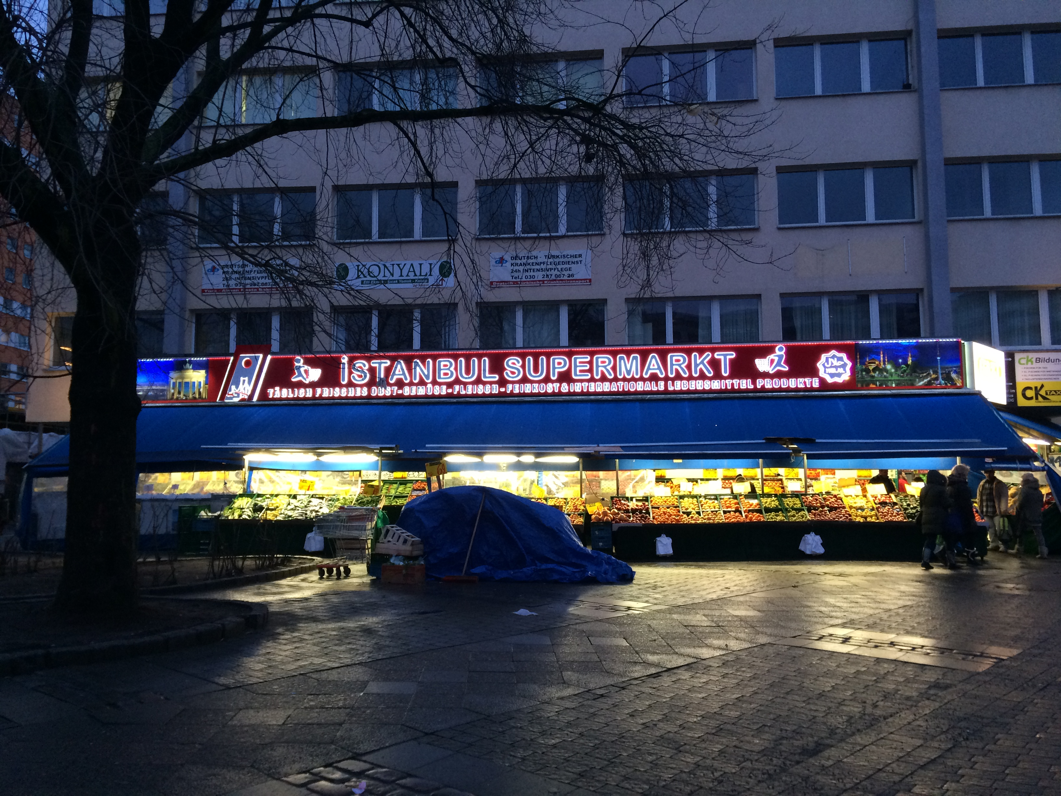
Managerial Implications
The animosity of German-Turks does not create a severe threat for German brands currently
BUT!!! if the tension depending on cultural animosity increase???
Competitive pressure of Turkish stores and brands in the German market

Slide 20
Limitations and Recommendations for Further Studies
The findings cannot be generalized to other minority groups.
The results also could differ when this research has applied in rural areas of Germany.
Finally, future research can focus on the same subject from the perspective of native Germans.

Slide 21
Thanks for listening
ozgeozgen@gmail.com

