Slide 1

21ST MARKETING CONGRESS
IMPACTS OF GAMIFICATION ON LOGISTICS AND SUPPLY CHAIN EDUCATION:
Chip Supply Case Study
Erhan DEMİRBAŞ
&
Gamze ARABELEN

Slide 2
AGENDA
Introduction
Gamification
Methodology
Game Information
Game-Play Process
Expected Outputs
Findings
Limitations
Conclusion & Further Research

Slide 3
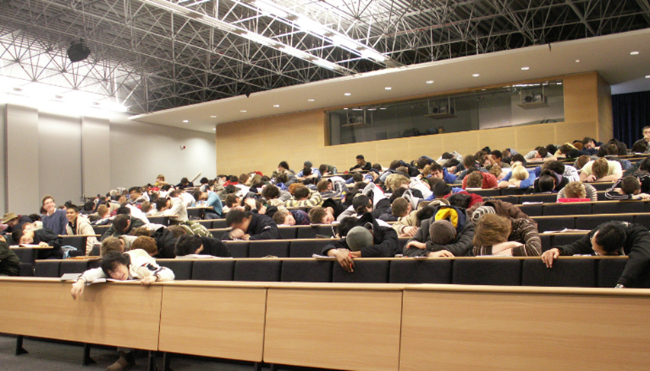
Introduction
Logistics and Supply Chain Education;
Growing importance of supply chain managers
Importance of education programs
Major problems: Motivation & engagement
Lecturing is the most used way
Boring experience
Gamification

Slide 4
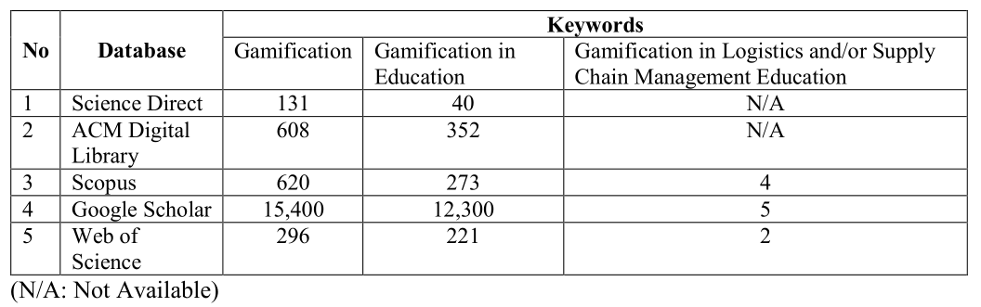
Purpose and Motivation of the Study
The purpose of this study is to present which impacts concept of gamification reveals on logistics and supply chain management

Slide 5

Gamification
«Gamification is basically the use of game design elements in non-game contents.»
(Deterding, et al., 2011)
Game elements
Motivation and engagement
According to Lee and Hummer (2011), gamification can provide an opportunity to help educators in order to solve motivational problems and improve student engagement.

Slide 6


Gamification
Gamification is adopted in many sectors including
Organization management
Service training
Health
Marketing
Education etc.

Slide 7

Methodology
Exploratory research
Judgmental sampling
Small sample size, 30 participants
“Chip Supply Game” has been developed
Survey implemented after game-play

Slide 8
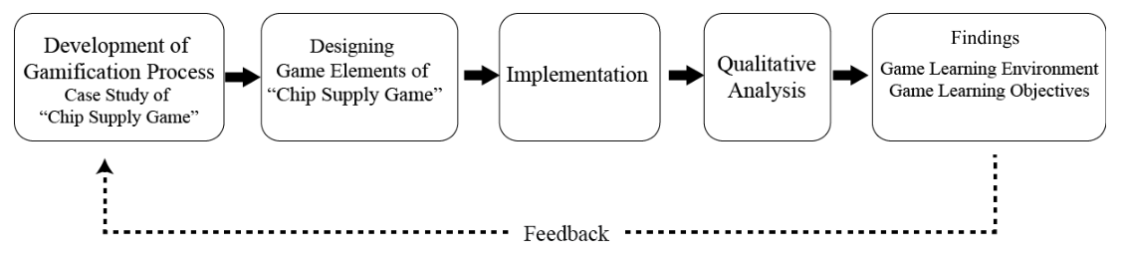
Research Model
Gamification process
Implementation
Analysis
Findings

Slide 9
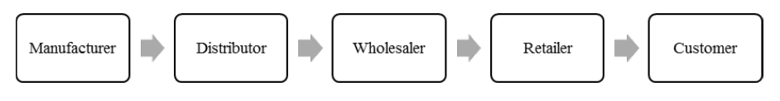
Game Information
Representation of a supply chain
Bullwhip effect
Manufacturing CPUs for computer manufacturers
Must meet customer order
Minimize holding inventory
Do not run out!

Slide 10
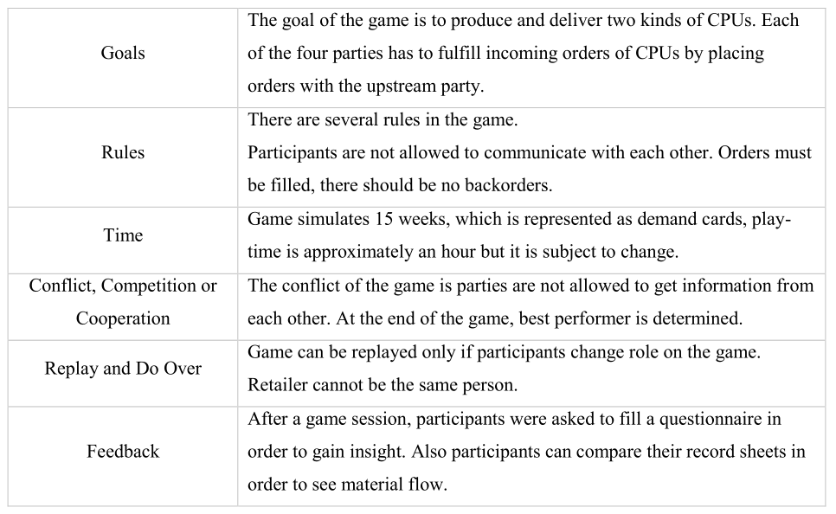
Game Elements of Chip Supply Game

Slide 11

Expected Output
To understand importance of information sharing
To understand how systematic thinking differs from individual thinking
To see how parties affect each other
To see the results of bullwhip effect
To deal with quantity of inventory

Slide 12
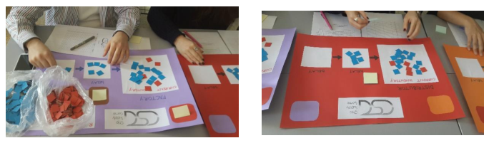
Implementation
30 participants
One week time period
15 rounds, each round representing one week of material flow

Slide 13
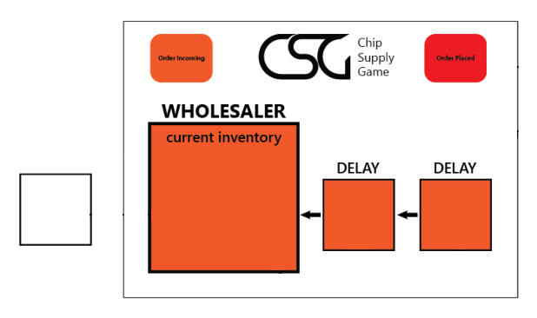



Game-Play Process
5 BLUE CHIPS
ORDER INCOMING
Record your inventory
YOUR ORDER

Slide 14
Findings
Game Insight
Difficult handicap, to decide on amount of order
During the game-play, unfilled backorders have occurred. Due to that situation, orders remained unfilled and the participants had to increase the amount in order to fulfill
the backorder.
Participants also stated that lack of information sharing makes difficult to determine the order.

Slide 15
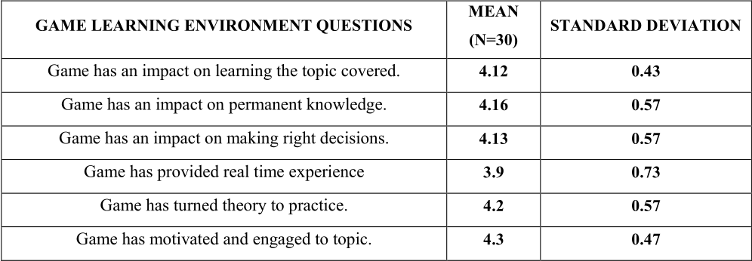
Findings
Game Learning Environment
MEAN = 30
STANDART DEVIATION

Slide 16
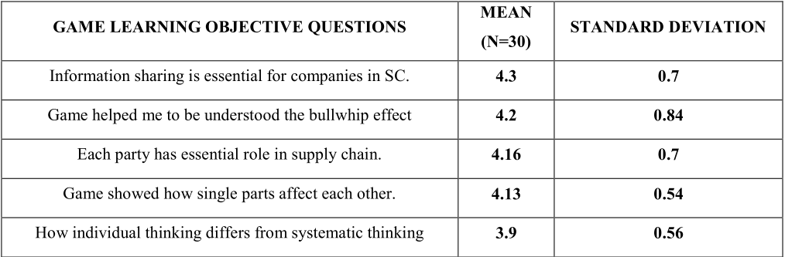
Findings
Game Learning Objectives
MEAN = 30
STANDART DEVIATION
Game helped me understand bullwhip effect

Slide 17
Limitations
Exploratory research
To get insight from participants
Small sample size
Focus group study after the implementation
More tools will enrich future studies

Slide 18
Conclusions and Further Research
Traditional learning environment, problem of engagement and motivation
Exploratory research
Gamification as an alternative
Aim is to show whether gamification motivates students to content in more engaging way or not
Participants stated that game has motivated and engaged them
Researchers should consider exploring more on impacts of gamification in L&SC education

Slide 19
THANK YOU FOR LISTENING

